Slide 1
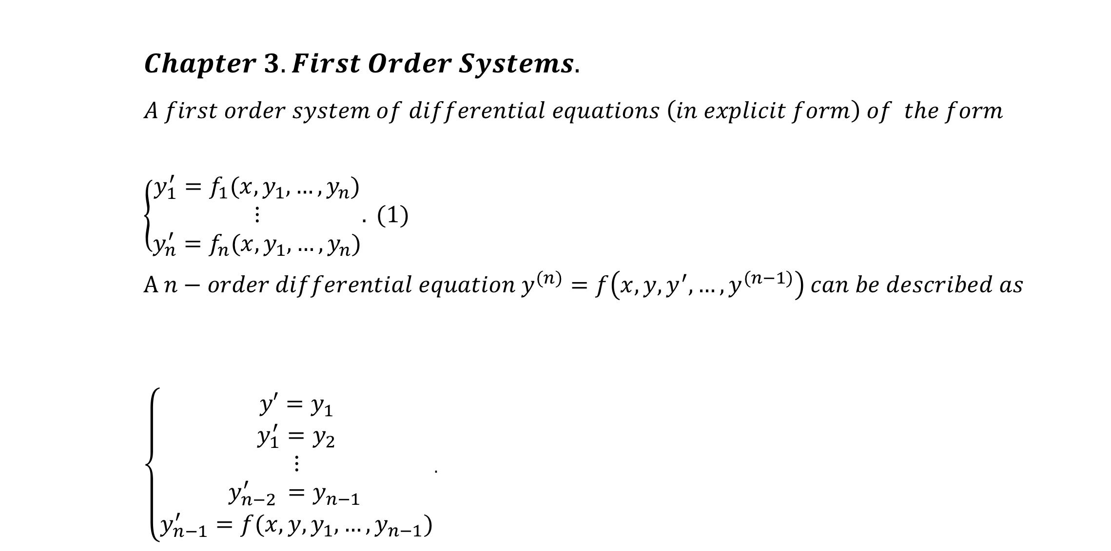
$$Chapter 3. First Order Systems. \\ A first order system of differential equations \left(in explicit form\right) of the form \\ \left\{\begin{aligned}y_{1}^{′}=f_{1}(x,y_{1},…,y_{n}) \\ ⋮ \\ y_{n}^{′}=f_{n}(x,y_{1},…,y_{n})\end{aligned}.\right. (1) \\ A n−order differential equation y^{(n)}=f\left(x,y,y^{′},…,y^{(n−1)}\right) can be described as$$ $\left\{\begin{aligned}y′=y_{1} \\ y_{1}^{′}=y_{2} \\ ⋮ \\ y_{n−2 }^{′}=y_{n−1 } \\ y_{n−1}^{′}=f(x,y,y_{1},…,y_{n−1})\end{aligned}\right.$.

Slide 2
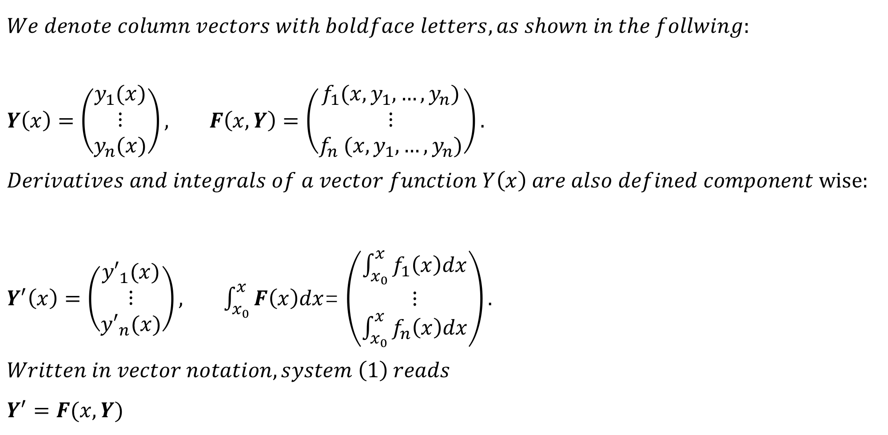
$$We denote column vectors with boldface letters, as shown in the follwing:$$ $Y\left(x\right)=\left(\begin{matrix}y_{1}(x) \\ ⋮ \\ y_{n}(x)\end{matrix}\right), F\left(x,Y\right)=$ $\left(\begin{matrix}f_{1}(x,y_{1},…,y_{n}) \\ ⋮ \\ f_{n} (x,y_{1},…,y_{n})\end{matrix}\right).$ $$Derivatives and integrals of a vector function Y\left(x\right) are also defined component wise:$$ $Y^{′}\left(x\right)=\left(\begin{matrix}{y′}_{1}(x) \\ ⋮ \\ {y′}_{n}(x)\end{matrix}\right), \int_{x_{0}}^{x}{F\left(x\right)dx}$= $\left(\begin{matrix}\int_{x_{0}}^{x}{f_{1}\left(x\right)dx} \\ ⋮ \\ \int_{x_{0}}^{x}{f_{n}\left(x\right)dx}\end{matrix}\right).$ $$Written in vector notation, system \left(1\right) reads \\ Y^{′}=F(x,Y)$$

Slide 3
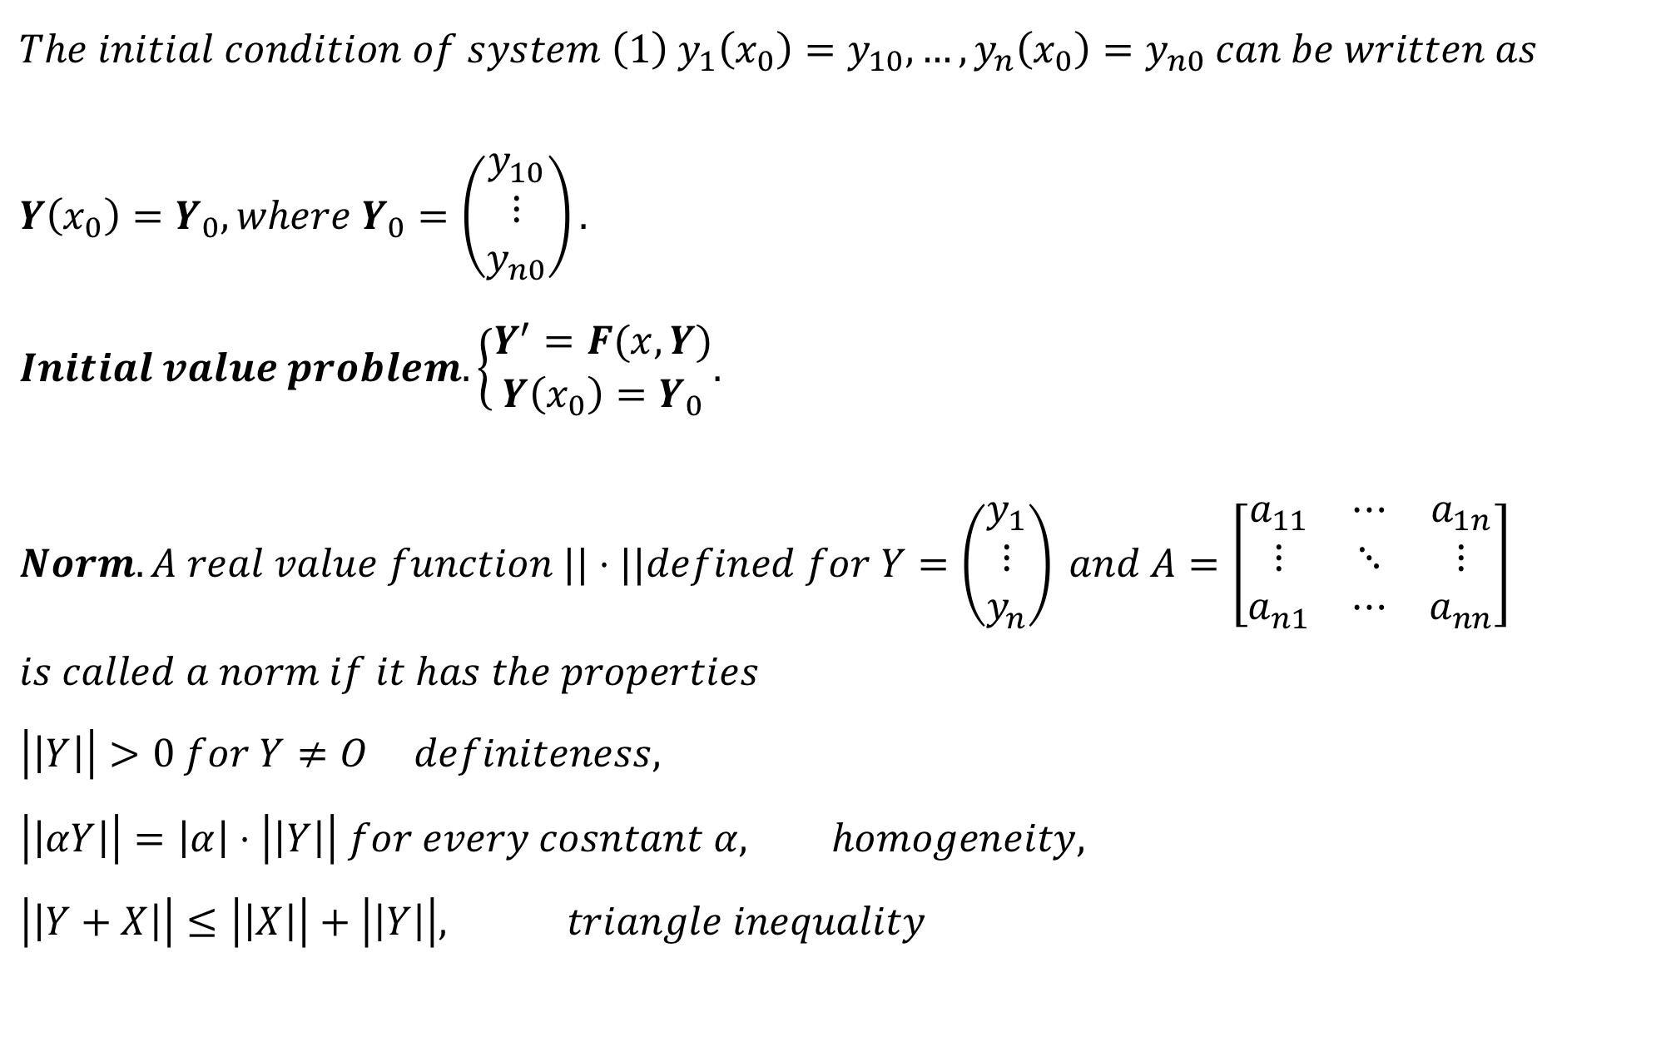
$$The initial condition of system \left(1\right) y_{1}\left(x_{0}\right)=y_{10}, …, y_{n}\left(x_{0}\right)=y_{n0} can be written as \\ Y\left(x_{0}\right)=Y_{0}, where Y_{0}=\left(\begin{matrix}y_{10} \\ ⋮ \\ y_{n0}\end{matrix}\right). \\ Initial value problem. \left\{\begin{aligned}Y^{′}=F(x,Y) \\ Y\left(x_{0}\right)=Y_{0}\end{aligned}.\right. \\ Norm.A real value function ||⋅||defined for Y=\left(\begin{matrix}y_{1} \\ ⋮ \\ y_{n}\end{matrix}\right) and A=\left[\begin{matrix}a_{11} & ⋯ & a_{1n} \\ ⋮ & ⋱ & ⋮ \\ a_{n1} & ⋯ & a_{nn}\end{matrix}\right] \\ is called a norm if it has the properties \\ \left|\left|Y\right|\right|>0 for Y≠O definiteness, \\ \left|\left|αY\right|\right|=\left|α\right|⋅\left|\left|Y\right|\right| for every cosntant α, homogeneity, \\ \left|\left|Y+X\right|\right|≤\left|\left|X\right|\right|+\left|\left|Y\right|\right|, triangle inequality$$

Slide 4
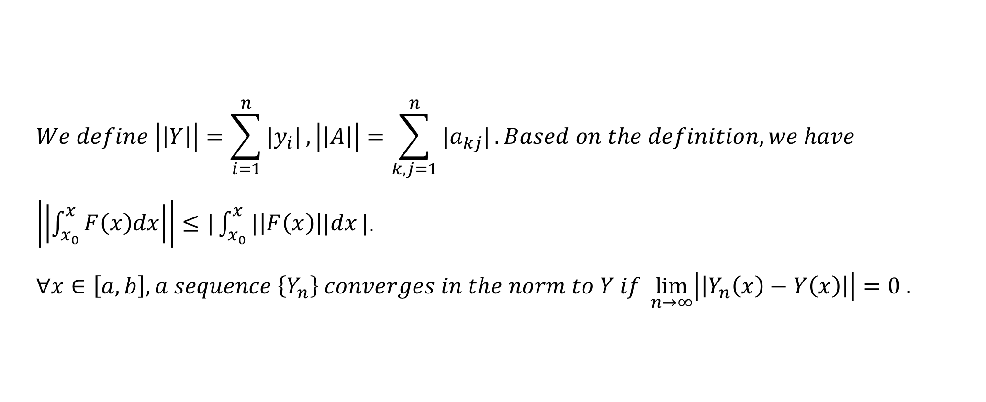
$$We define \left|\left|Y\right|\right|=\sum_{i=1}^{n}{|y_{i}|},\left|\left|A\right|\right|=\sum_{k,j=1}^{n}{|a_{kj}|}. Based on the definition, we have$$ $\left|\left|\int_{x_{0}}^{x}{F\left(x\right)dx}\right|\right|≤|\int_{x_{0}}^{x}{|\left|F\left(x\right)\right||dx}|$. $$∀x∈\left[a,b\right], a sequence \left\{Y_{n}\right\} converges in the norm to Y if \lim_{n→∞}\left|\left|Y_{n}\left(x\right)−Y\left(x\right)\right|\right|=0 .$$

Slide 5
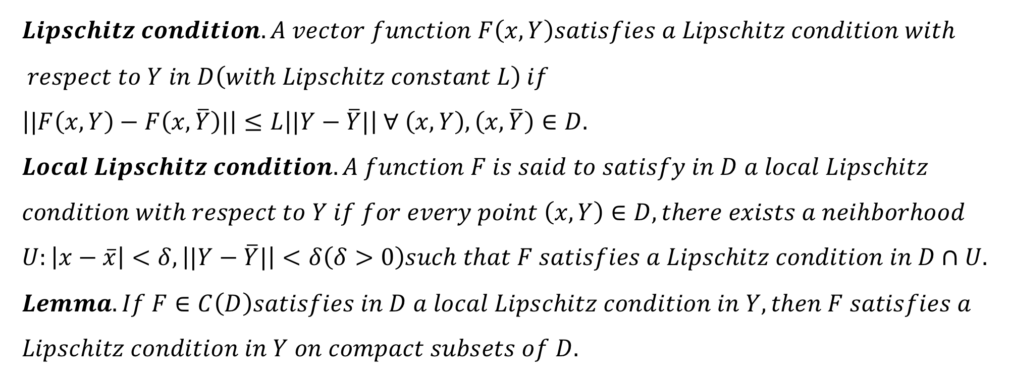
$$Lipschitz condition. A vector function F\left(x,Y\right)satisfies a Lipschitz condition with \\ respect to Y in D\left(with Lipschitz constant L\right) if \\ \left||F\left(x,Y\right)−F\left(x,\overline{Y}\right)|\right|≤L\left||Y−\overline{Y}|\right| ∀ \left(x,Y\right),\left(x,\overline{Y}\right)∈D. \\ Local Lipschitz condition. A function F is said to satisfy in D a local Lipschitz \\ condition with respect to Y if for every point \left(x,Y\right)∈D, there exists a neihborhood \\ U:\left|x−\overline{x}\right|<δ,\left||Y−\overline{Y}|\right|<δ\left(δ>0\right)such that F satisfies a Lipschitz condition in D∩U. \\ Lemma. If F∈C\left(D\right)satisfies in D a local Lipschitz condition in Y, then F satisfies a \\ Lipschitz condition in Y on compact subsets of D.$$

Slide 6
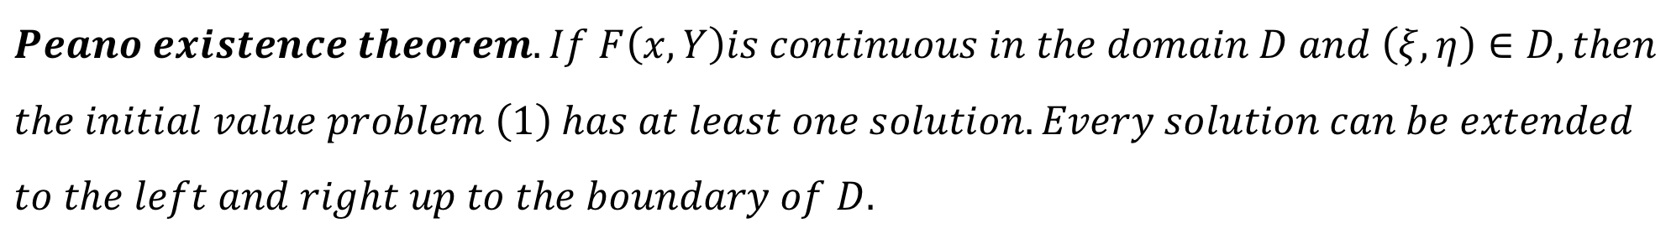
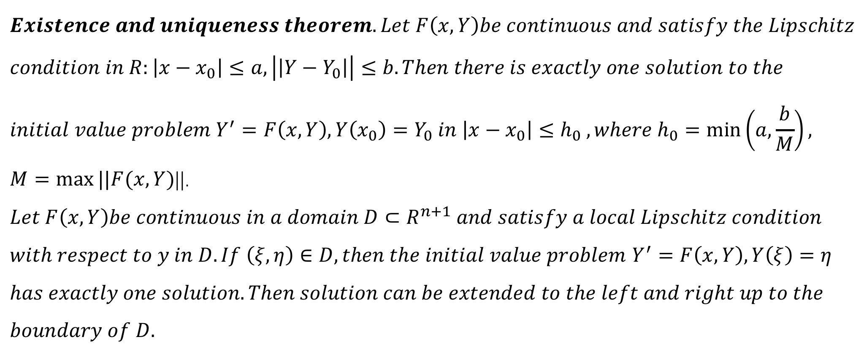
$$Existence and uniqueness theorem. Let F\left(x,Y\right)be continuous and satisfy the Lipschitz \\ condition in R:\left|x−x_{0}\right|≤a,\left|\left|Y−Y_{0}\right|\right|≤b.Then there is exactly one solution to the \\ initial value problem Y^{′}=F\left(x,Y\right), Y\left(x_{0}\right)=Y_{0} in \left|x−x_{0}\right|≤h_{0} , where h_{0}=\min\left(a,\frac{b}{M}\right),$$ $M=\max{||F(x,Y)}$||. $$Let F\left(x,Y\right)be continuous in a domain D⊂R^{n+1} and satisfy a local Lipschitz condition$$ $with respect to y in D. If \left(ξ,η\right)∈D, then the initial value problem$ $Y^{′}=F\left(x,Y\right), Y\left(ξ\right)=η$ $$has exactly one solution. Then solution can be extended to the left and right up to the \\ boundary of D.$$
$$Peano existence theorem. If F\left(x,Y\right)is continuous in the domain D and \left(ξ,η\right)∈D, then \\ the initial value problem \left(1\right) has at least one solution. Every solution can be extended \\ to the left and right up to the boundary of D.$$

Slide 7
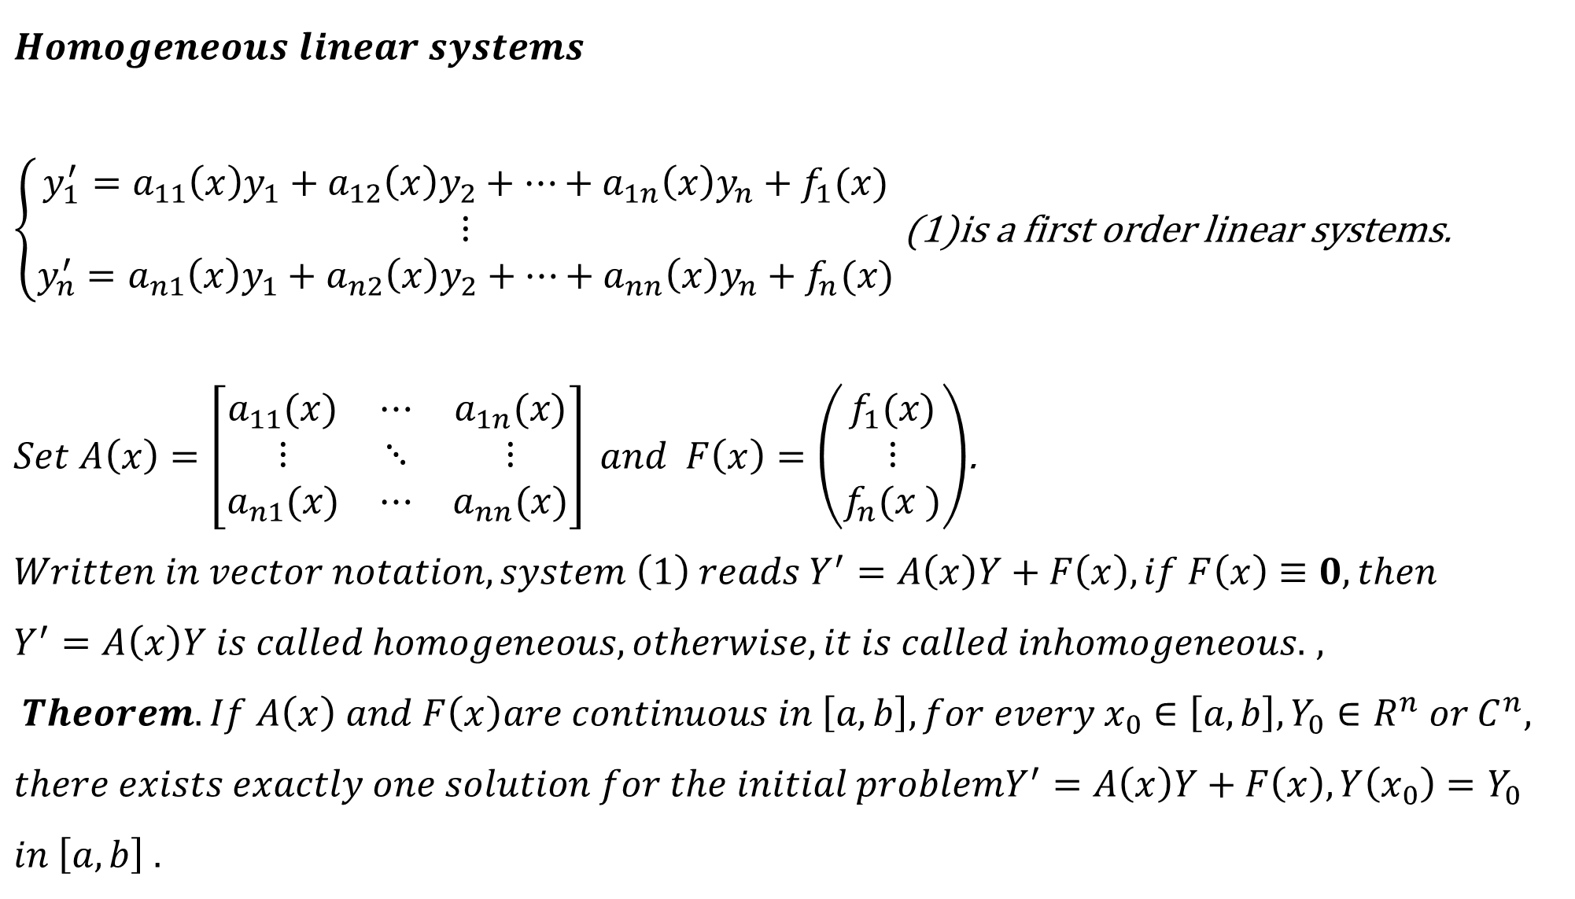
$$Homogeneous linear systems$$ $\left\{\begin{aligned}y_{1}^{′}=a_{11}\left(x\right)y_{1}+a_{12}\left(x\right)y_{2}+…+a_{1n}\left(x\right)y_{n}+f_{1}(x) \\ ⋮ \\ y_{n}^{′}=a_{n1}\left(x\right)y_{1}+a_{n2}\left(x\right)y_{2}+…+a_{nn}\left(x\right)y_{n}+f_{n}(x)\end{aligned}\right.$ (1)is a first order linear systems.
$Set A\left(x\right)=\left[\begin{matrix}a_{11}(x) & ⋯ & a_{1n}(x) \\ ⋮ & ⋱ & ⋮ \\ a_{n1}(x) & ⋯ & a_{nn}(x)\end{matrix}\right] and F\left(x\right)=\left(\begin{matrix}f_{1}(x) \\ ⋮ \\ f_{n}(x )\end{matrix}\right)$.
$$Written in vector notation, system \left(1\right) reads Y^{′}=A\left(x\right)Y+F\left(x\right), if F\left(x\right)≡0,then$$ $Y^{′}=A\left(x\right)Y is called homogeneous, otherwise, it is called inhomogeneous.$ $,$ $$Theorem. If A\left(x\right) and F\left(x\right)are continuous in \left[a,b\right], for every x_{0}∈\left[a,b\right], Y_{0}∈R^{n} or C^{n}, \\ there exists exactly one solution for the initial problemY^{′}=A\left(x\right)Y+F\left(x\right), Y\left(x_{0}\right)=Y_{0} \\ in \left[a,b\right] .$$

Slide 8
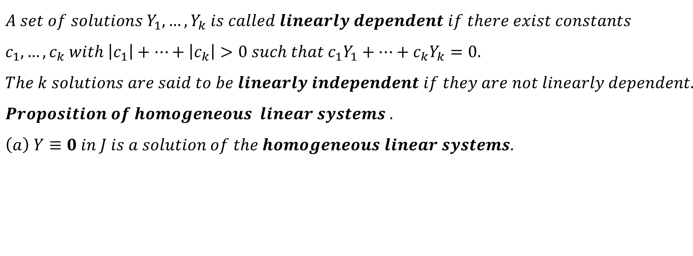
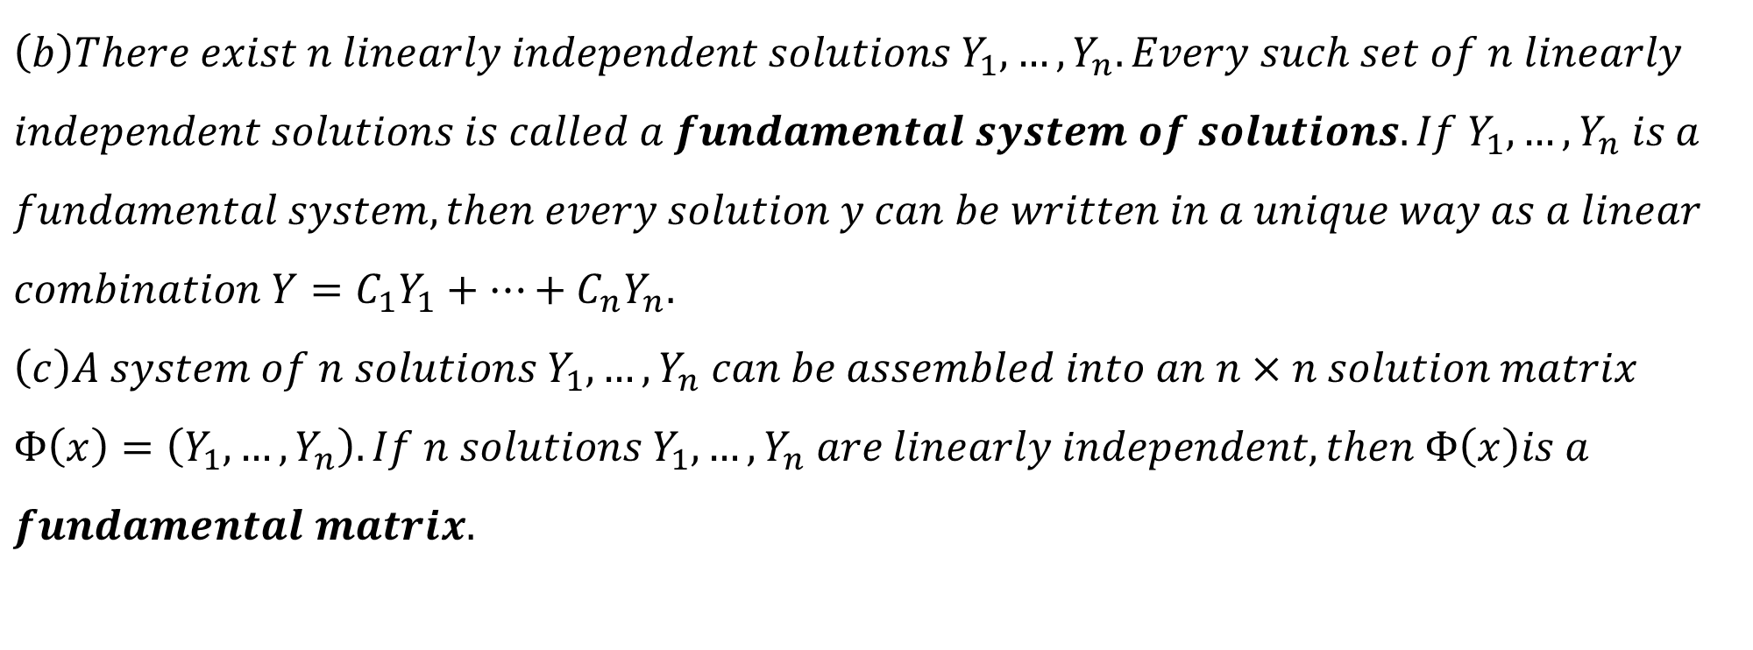
$$A set of solutions Y_{1},…,Y_{k} is called linearly dependent if there exist constants \\ c_{1},…,c_{k} with \left|c_{1}\right|+…+\left|c_{k}\right|>0 such that c_{1}Y_{1}+…+c_{k}Y_{k}=0. \\ The k solutions are said to be linearly independent if they are not linearly dependent. \\ Proposition of homogeneous linear systems . \\ \left(a\right) Y≡0 in J is a solution of the homogeneous linear systems.$$
$$\left(b\right)There exist n linearly independent solutions Y_{1},…,Y_{n}. Every such set of n linearly \\ independent solutions is called a fundamental system of solutions. If Y_{1},…,Y_{n} is a \\ fundamental system, then every solution y can be written in a unique way as a linear \\ combination Y=C_{1}Y_{1}+…+C_{n}Y_{n}. \\ \left(c\right)A system of n solutions Y_{1},…,Y_{n} can be assembled into an n×n solution matrix \\ Φ\left(x\right)=\left(Y_{1},…,Y_{n}\right). If n solutions Y_{1},…,Y_{n} are linearly independent, then Φ\left(x\right)is a \\ fundamental matrix.$$

Slide 9
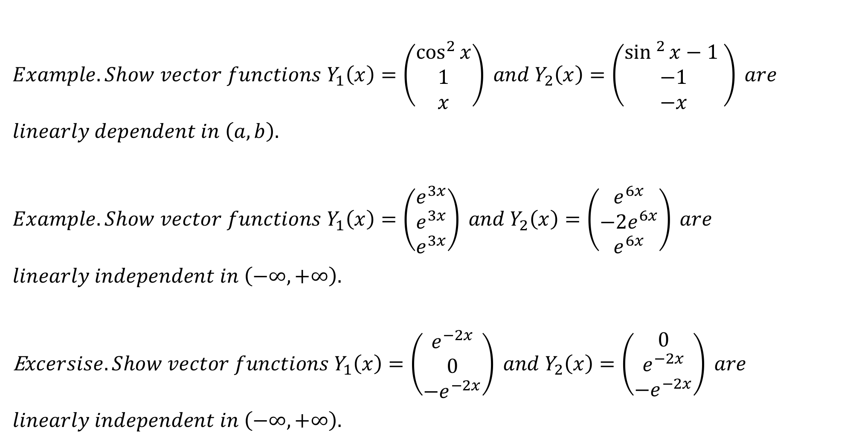
$$Example. Show vector functions Y_{1}\left(x\right)=\left(\begin{matrix}\cos^{2}{x} \\ 1 \\ x\end{matrix}\right) and Y_{2}\left(x\right)=\left(\begin{matrix}\sin^{2}{x}−1 \\ −1 \\ −x\end{matrix}\right) are \\ linearly dependent in \left(a,b\right).$$
$$Example. Show vector functions Y_{1}\left(x\right)=\left(\begin{matrix}e^{3x} \\ e^{3x} \\ e^{3x}\end{matrix}\right) and Y_{2}\left(x\right)=\left(\begin{matrix}e^{6x} \\ −2e^{6x} \\ e^{6x}\end{matrix}\right) are \\ linearly independent in \left(−∞,+∞\right).$$ E$xcersise.Show vector functions Y_{1}\left(x\right)=\left(\begin{matrix}e^{−2x} \\ 0 \\ −e^{−2x}\end{matrix}\right) and Y_{2}\left(x\right)=\left(\begin{matrix}0 \\ e^{−2x} \\ −e^{−2x}\end{matrix}\right) are$ $$linearly independent in \left(−∞,+∞\right).$$

Slide 10
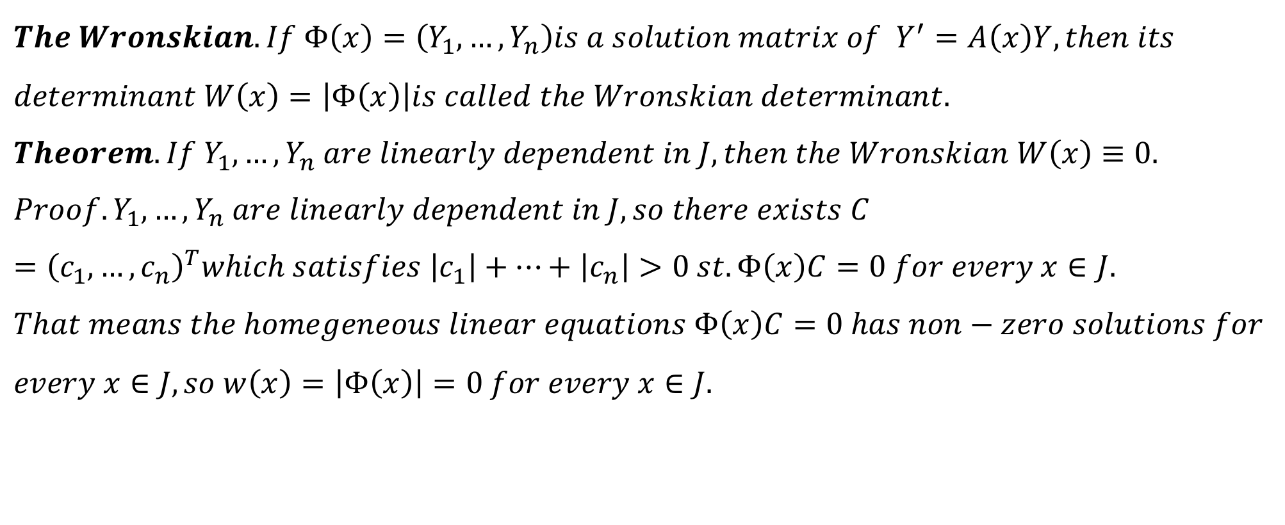
$$The Wronskian. If Φ\left(x\right)=\left(Y_{1},…,Y_{n}\right)is a solution matrix of Y^{′}=A\left(x\right)Y, then its \\ determinant W\left(x\right)=\left|Φ\left(x\right)\right|is called the Wronskian determinant. \\ Theorem.If Y_{1},…,Y_{n} are linearly dependent in J, then the Wronskian W\left(x\right)≡0. \\ Proof.Y_{1},…,Y_{n} are linearly dependent in J, so there exists C={\left(c_{1},…,c_{n}\right)}^{T}which satisfies \left|c_{1}\right|+…+\left|c_{n}\right|>0 st. Φ\left(x\right)C=0 for every x∈J. \\ That means the homegeneous linear equations Φ\left(x\right)C=0 has non−zero solutions for \\ every x∈J, so w\left(x\right)=\left|Φ\left(x\right)\right|=0 for every x∈J.$$

Slide 11
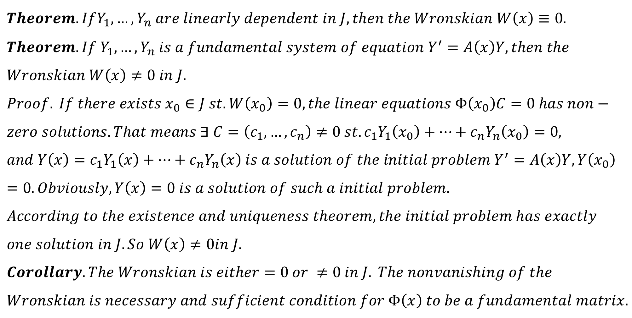
$$Theorem.IfY_{1},…,Y_{n} are linearly dependent in J, then the Wronskian W\left(x\right)≡0. \\ Theorem. If Y_{1},…,Y_{n} is a fundamental system of equation Y^{′}=A\left(x\right)Y, then the \\ Wronskian W\left(x\right)≠0 in J. \\ Proof. If there exists x_{0}∈J st. W\left(x_{0}\right)=0, the linear equations Φ\left(x_{0}\right)C=0 has non− \\ zero solutions. That means ∃ C=\left(c_{1},…,c_{n}\right)≠0 st. c_{1}Y_{1}\left(x_{0}\right)+…+c_{n}Y_{n}\left(x_{0}\right)=0, \\ and Y\left(x\right)=c_{1}Y_{1}\left(x\right)+…+c_{n}Y_{n}\left(x\right) is a solution of the initial problem Y^{′}=A\left(x\right)Y,Y\left(x_{0}\right)=0. Obviously, Y\left(x\right)=0 is a solution of such a initial problem. \\ According to the existence and uniqueness theorem, the initial problem has exactly \\ one solution in J. So W\left(x\right)≠0in J. \\ Corollary. The Wronskian is either=0 or ≠0 in J. The nonvanishing of the \\ Wronskian is necessary and sufficient condition for Φ\left(x\right) to be a fundamental matrix.$$

Slide 12
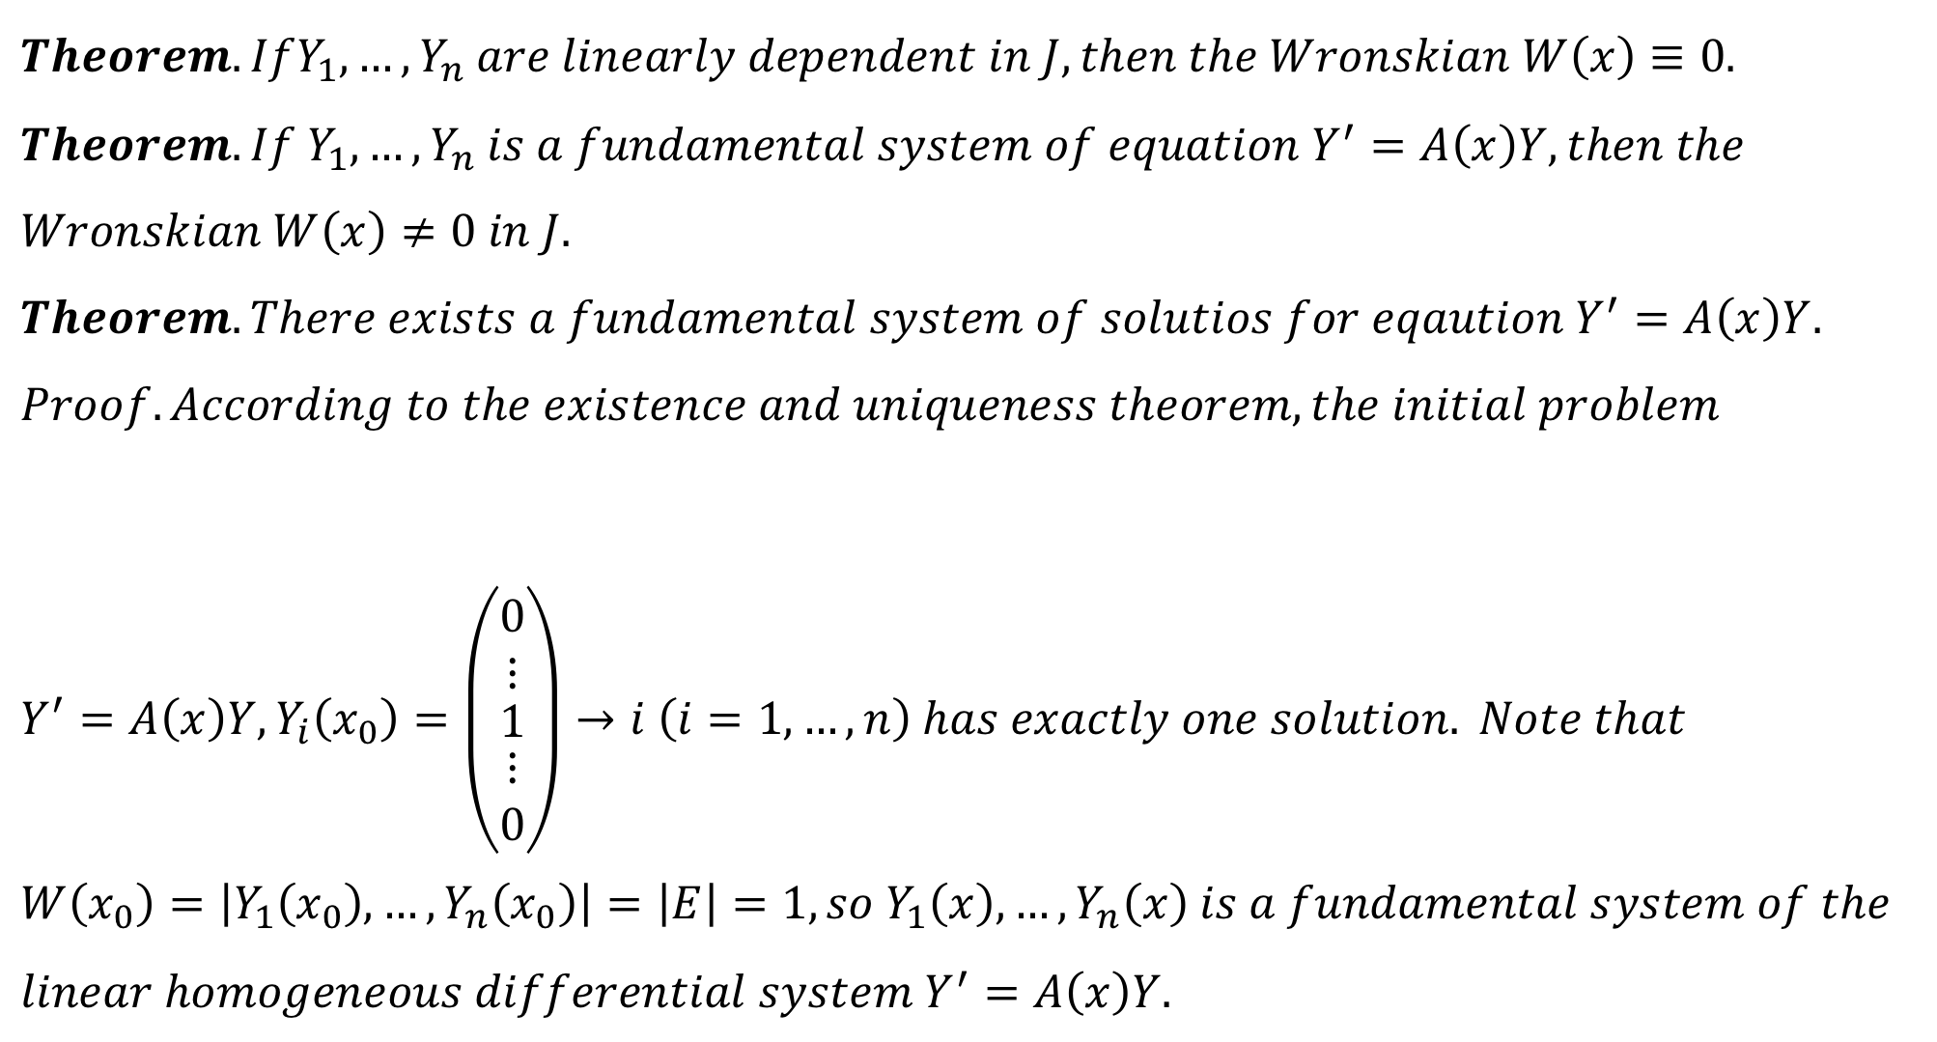
$$Theorem.IfY_{1},…,Y_{n} are linearly dependent in J, then the Wronskian W\left(x\right)≡0. \\ Theorem. If Y_{1},…,Y_{n} is a fundamental system of equation Y^{′}=A\left(x\right)Y, then the \\ Wronskian W\left(x\right)≠0 in J. \\ Theorem. There exists a fundamental system of solutios for eqaution Y^{′}=A\left(x\right)Y.$$
$$Proof. According to the existence and uniqueness theorem, the initial problem \\ Y^{′}=A\left(x\right)Y,Y_{i}\left(x_{0}\right)=\left(\begin{matrix}\begin{matrix}0 \\ ⋮\end{matrix} \\ 1 \\ \begin{matrix}⋮ \\ 0\end{matrix}\end{matrix}\right)→i \left(i=1,…,n\right) has exactly one solution. Note that \\ W\left(x_{0}\right)=\left|Y_{1}\left(x_{0}\right),…,Y_{n}\left(x_{0}\right)\right|=\left|E\right|=1, so Y_{1}\left(x\right),…,Y_{n}\left(x\right) is a fundamental system of the \\ linear homogeneous differential system Y^{′}=A\left(x\right)Y.$$

Slide 13
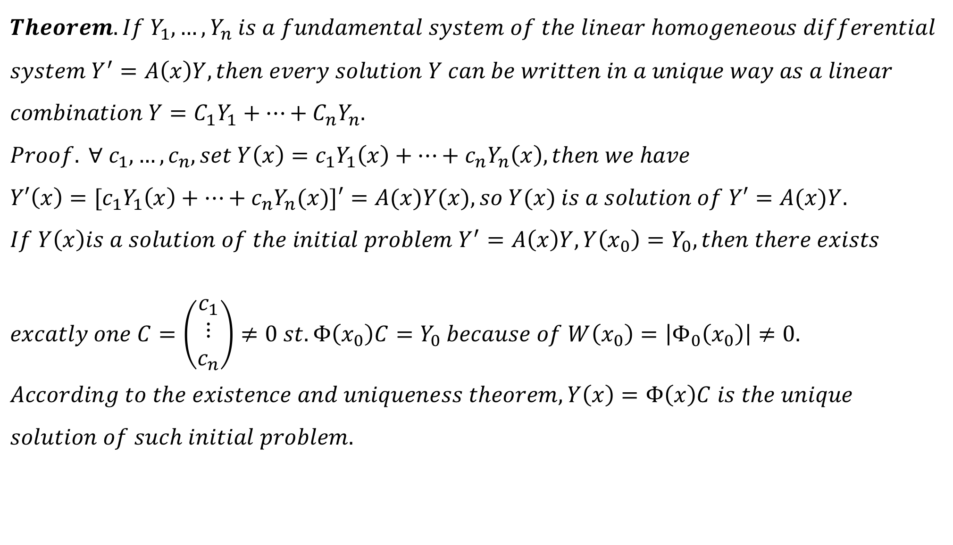
$$Theorem. If Y_{1},…,Y_{n} is a fundamental system of the linear homogeneous differential \\ system Y^{′}=A\left(x\right)Y, then every solution Y can be written in a unique way as a linear \\ combination Y=C_{1}Y_{1}+…+C_{n}Y_{n}. \\ Proof. ∀ c_{1},…,c_{n}, set Y\left(x\right)=c_{1}Y_{1}\left(x\right)+…+c_{n}Y_{n}\left(x\right), then we have \\ Y′\left(x\right)={[c}_{1}Y_{1}\left(x\right)+…+c_{n}Y_{n}(x)]′=A(x)Y(x), so Y(x) is a solution of Y′=A(x)Y. \\ If Y\left(x\right)is a solution of the initial problem Y^{′}=A\left(x\right)Y,Y\left(x_{0}\right)=Y_{0}, then there exists \\ excatly one C=\left(\begin{matrix}c_{1} \\ ⋮ \\ c_{n}\end{matrix}\right)≠0 st. Φ\left(x_{0}\right)C=Y_{0} because of W\left(x_{0}\right)=\left|Φ_{0}\left(x_{0}\right)\right|≠0. \\ According to the existence and uniqueness theorem, Y\left(x\right)=Φ\left(x\right)C is the unique \\ solution of such initial problem.$$

Slide 14
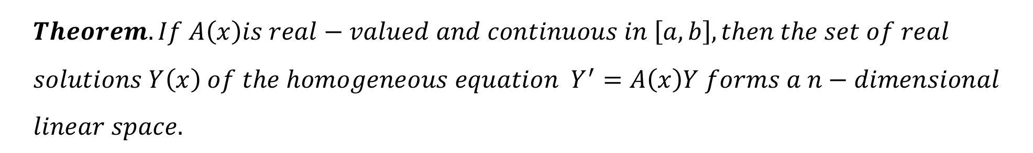
$$Theorem. If Y_{1},…,Y_{n} is a fundamental system of equation Y^{′}=A\left(x\right)Y, then every \\ solution Y can be written in a unique way as a linear combinationY=C_{1}Y_{1}+…+C_{n}Y_{n}.$$
$$Theorem. If A\left(x\right)is real−valued and continuous in \left[a,b\right], then the set of real \\ solutions Y\left(x\right) of the homogeneous equation Y^{′}=A\left(x\right)Y forms a n−dimensional \\ linear space.$$

Slide 15
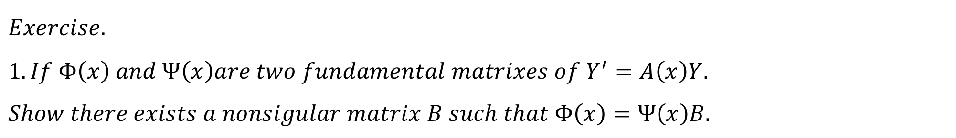
$$Exercise. \\ 1. If Φ\left(x\right) and Ψ\left(x\right)are two fundamental matrixes of Y^{′}=A\left(x\right)Y. \\ Show there exists a nonsigular matrix B such that Φ\left(x\right)=Ψ\left(x\right)B.$$

Slide 16
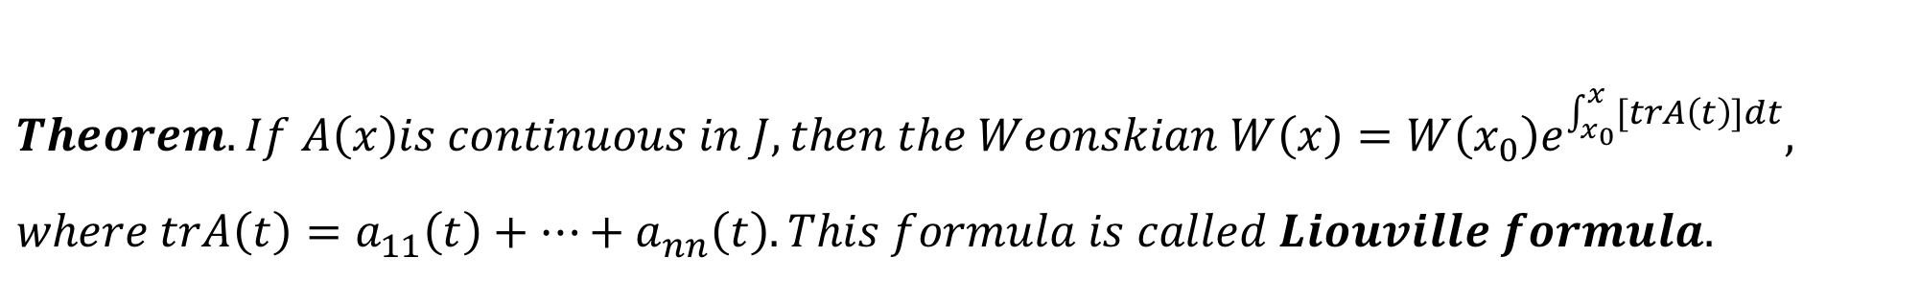
$$Theorem. If A\left(x\right)is continuous in J, then the Weonskian W\left(x\right)=W\left(x_{0}\right)e^{\int_{x_{0}}^{x}{[trA\left(t\right)]dt}}, \\ where trA\left(t\right)=a_{11}\left(t\right)+…+a_{nn}\left(t\right). This formula is called Liouville formula.$$

Slide 17
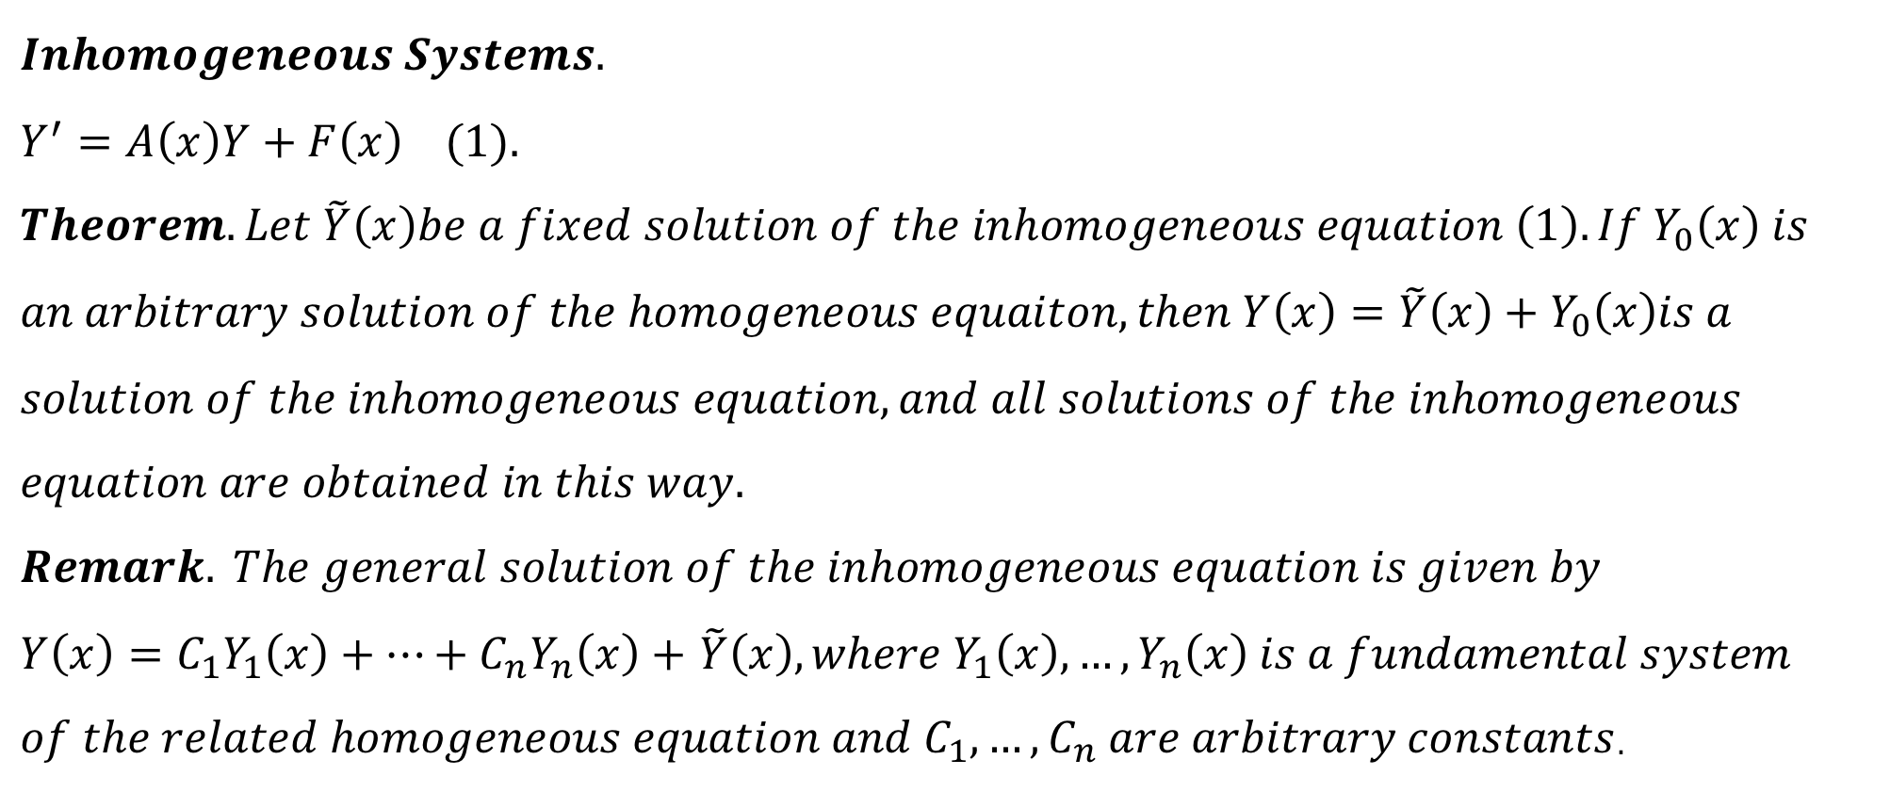
$$Inhomogeneous Systems. \\ Y^{′}=A\left(x\right)Y+F\left(x\right) (1). \\ Theorem. Let \tilde{Y}\left(x\right)be a fixed solution of the inhomogeneous equation \left(1\right). If Y_{0}\left(x\right) is \\ an arbitrary solution of the homogeneous equaiton, then Y\left(x\right)=\tilde{Y}\left(x\right)+Y_{0}\left(x\right)is a \\ solution of the inhomogeneous equation, and all solutions of the inhomogeneous \\ equation are obtained in this way. \\ Remark. The general solution of the inhomogeneous equation is given by$$ $Y\left(x\right)=C_{1}Y_{1}\left(x\right)+…+C_{n}Y_{n}\left(x\right)+$ $\tilde{Y}\left(x\right), where Y_{1}\left(x\right),…,Y_{n}\left(x\right) is a fundamental system$ $of the related homogeneous equation and C_{1},…,C_{n} are arbitrary constants$.

Slide 18
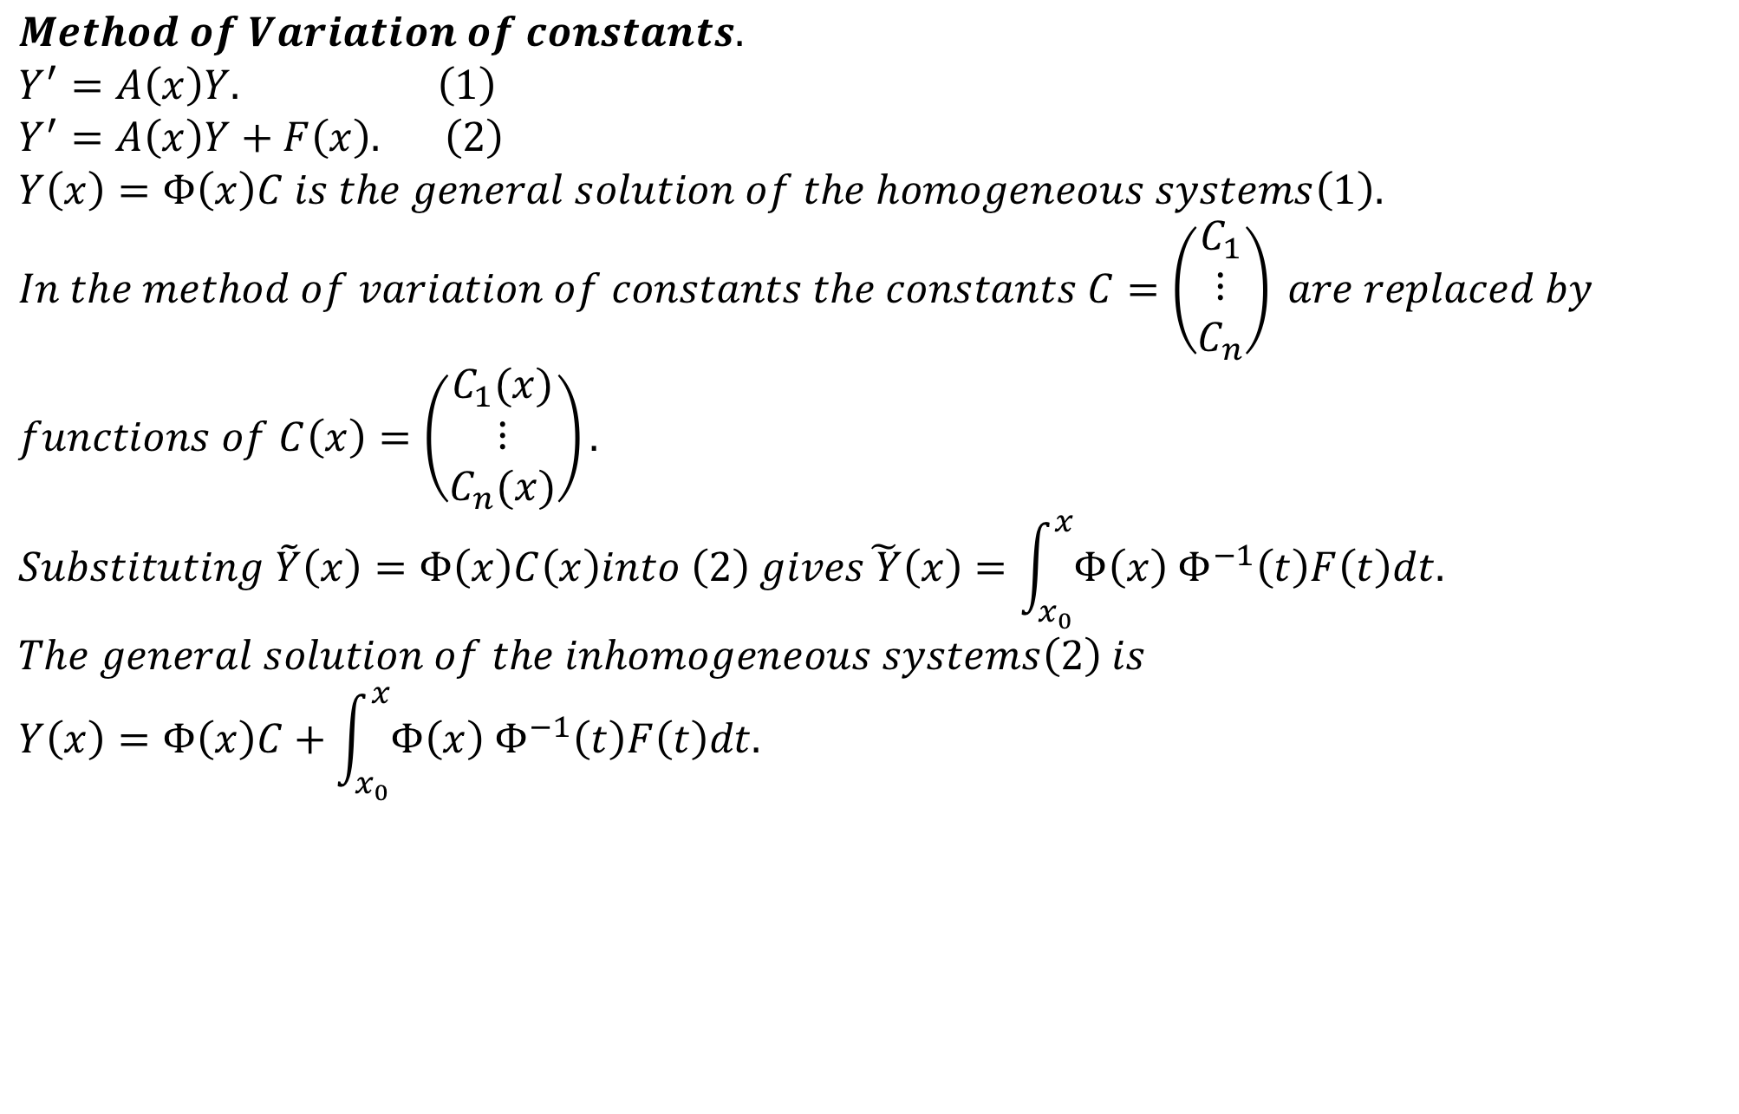
$$Method of Variation of constants. \\ Y^{′}=A\left(x\right)Y. \left(1\right) \\ Y^{′}=A\left(x\right)Y+F\left(x\right). \left(2\right) \\ Y\left(x\right)=Φ\left(x\right)C is the general solution of the homogeneous systems\left(1\right). \\ In the method of variation of constants the constants C=\left(\begin{matrix}C_{1} \\ ⋮ \\ C_{n}\end{matrix}\right) are replaced by \\ functions of C\left(x\right)=\left(\begin{matrix}C_{1}(x) \\ ⋮ \\ C_{n}(x)\end{matrix}\right). \\ Substituting \tilde{Y}\left(x\right)=Φ\left(x\right)C\left(x\right)into \left(2\right) gives\tilde{ Y}\left(x\right)=\int_{x_{0}}^{x}{Φ\left(x\right) Φ^{−1}\left(t\right)F\left(t\right)dt.} \\ The general solution of the inhomogeneous systems\left(2\right) is \\ Y\left(x\right)=Φ\left(x\right)C+\int_{x_{0}}^{x}{Φ\left(x\right) Φ^{−1}\left(t\right)F\left(t\right)dt.}$$

Slide 19
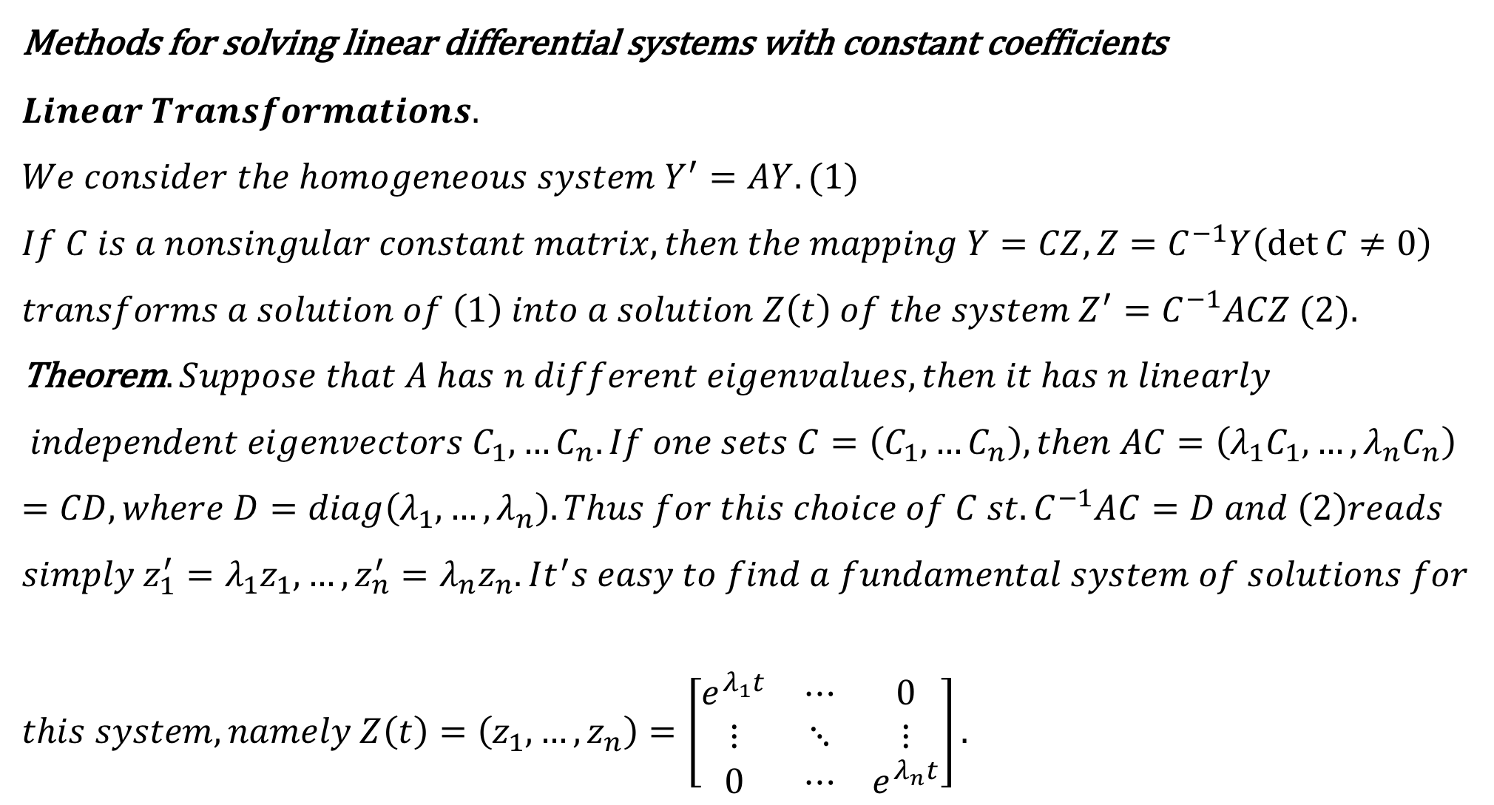
$$\text{Methods} \text{for} \text{solving} \text{linear} \text{differential} \text{systems} \text{with} \text{constant} \text{coefficients}$$
$$Linear Transformations.$$
$${We consider the homogeneous system Y}^{′}=AY.(1) \\ If C is a nonsingular constant matrix, then the mapping Y=CZ, Z=C^{−1}Y\left(\det{C≠0}\right) \\ transforms a solution of \left(1\right) into a solution Z\left(t\right) of the system Z^{′}=C^{−1}ACZ (2).$$ Theorem$. Suppose that A has n different eigenvalues, then it has n linearly$ $$independent eigenvectors C_{1},…C_{n}. If one sets C=\left(C_{1},…C_{n}\right), then AC=\left(λ_{1}C_{1},…,λ_{n}C_{n}\right)=CD, where D=diag\left(λ_{1},…,λ_{n}\right).Thus for this choice of C st. C^{−1}AC=D and \left(2\right)reads$$
$$simply z_{1}^{′}=λ_{1}z_{1},…,z_{n}^{′}=λ_{n}z_{n}. It^{′}s easy to find a fundamental system of solutions for \\ this system, namely Z\left(t\right)=\left(z_{1},…,z_{n}\right)=\left[\begin{matrix}e^{λ_{1}t} & ⋯ & 0 \\ ⋮ & ⋱ & ⋮ \\ 0 & ⋯ & e^{λ_{n}t}\end{matrix}\right].$$

Slide 20
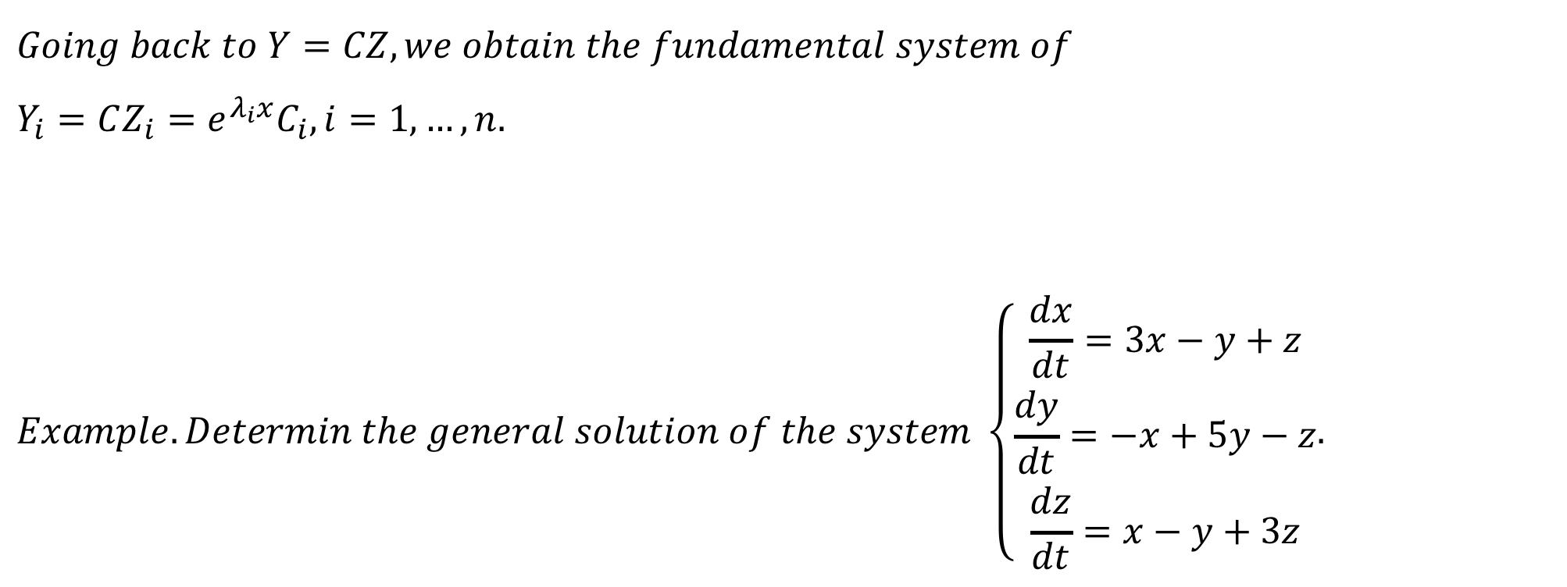
$$Going back to Y=CZ, we obtain the fundamental system of \\ Y_{i}=CZ_{i}=e^{λ_{i}x}C_{i}, i=1,…,n. \\ Example. Determin the general solution of the system \left\{\begin{matrix}\frac{dx}{dt}=3x−y+z \\ \frac{dy}{dt}=−x+5y−z \\ \frac{dz}{dt}=x−y+3z\end{matrix}.\right.$$

Slide 21
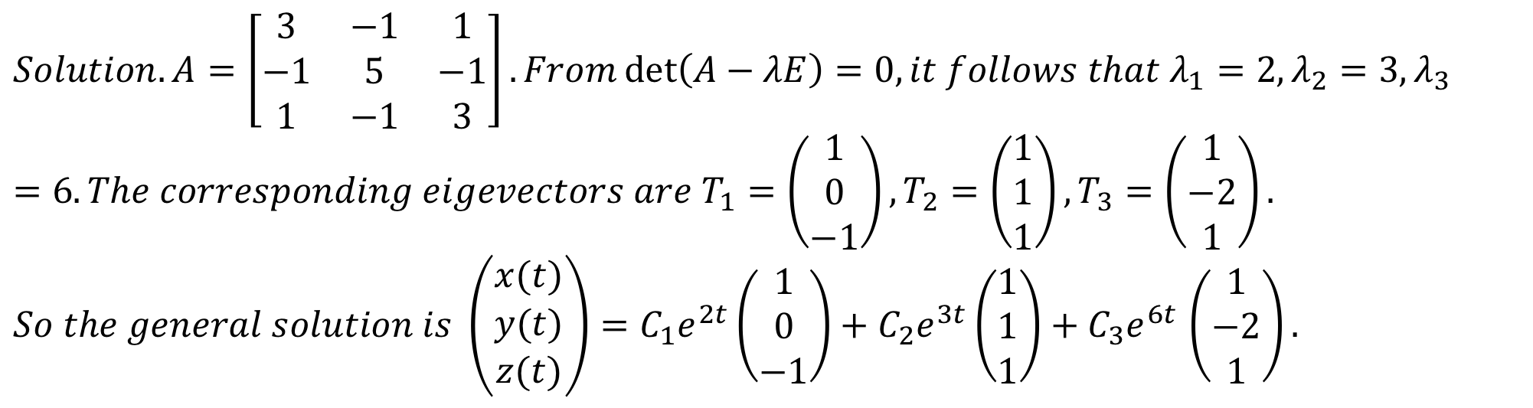
$$Solution. A=\left[\begin{matrix}3 & −1 & 1 \\ −1 & 5 & −1 \\ 1 & −1 & 3\end{matrix}\right]. From\det\left(A−λE\right)=0, it follows that λ_{1}=2,λ_{2}=3,λ_{3}=6. The corresponding eigevectors are T_{1}=\left(\begin{matrix}1 \\ 0 \\ −1\end{matrix}\right),T_{2}=\left(\begin{matrix}1 \\ 1 \\ 1\end{matrix}\right),T_{3}=\left(\begin{matrix}1 \\ −2 \\ 1\end{matrix}\right).$$ $So the general solution is \left(\begin{matrix}x(t) \\ y(t) \\ z(t)\end{matrix}\right)=C_{1}e^{2t}\left(\begin{matrix}1 \\ 0 \\ −1\end{matrix}\right)+C_{2}e^{3t}\left(\begin{matrix}1 \\ 1 \\ 1\end{matrix}\right)+C_{3}e^{6t}$ $\left(\begin{matrix}1 \\ −2 \\ 1\end{matrix}\right).$

Slide 22
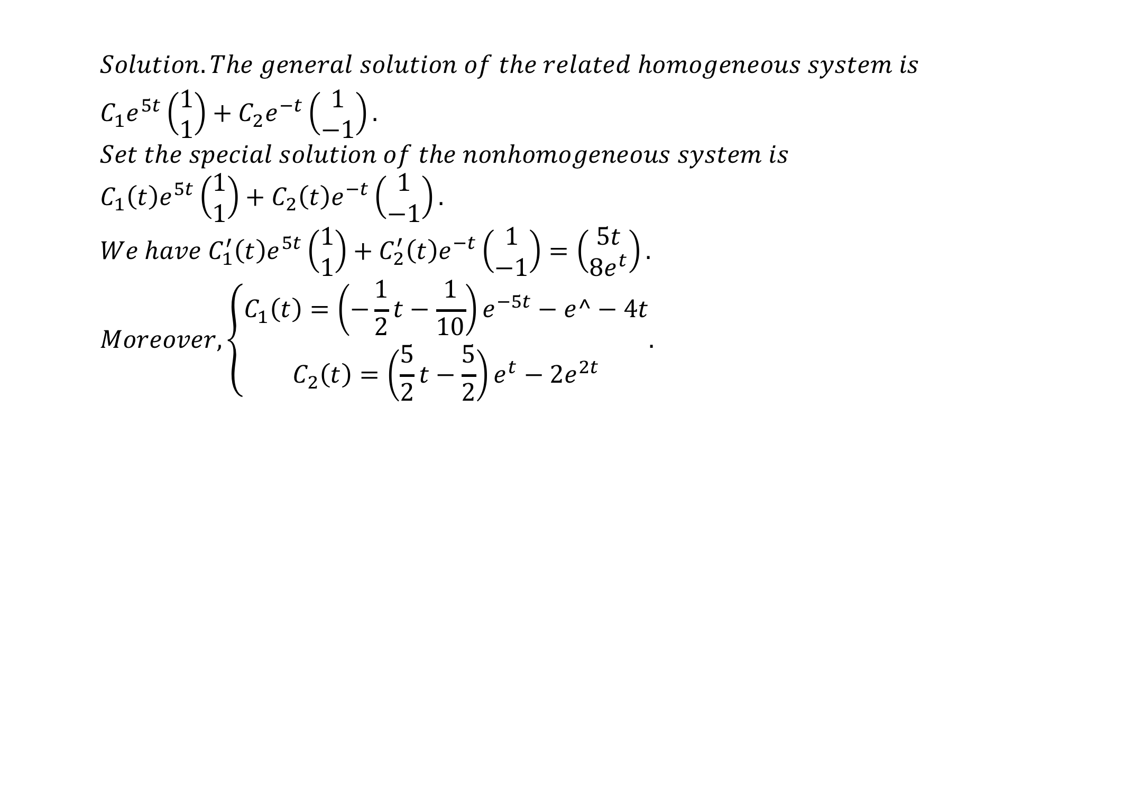
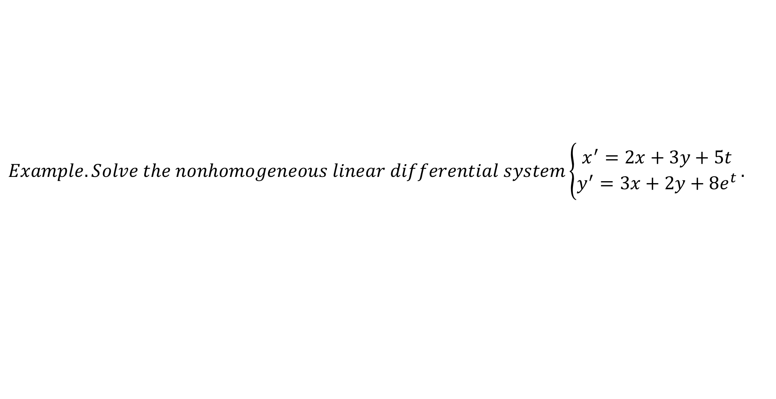
$$Example. Solve the nonhomogeneous linear differential system\left\{\begin{matrix}x^{′}=2x+3y+5t \\ y^{′}=3x+2y+8e^{t}\end{matrix}\right..$$
$$Solution. The general solution of the related homogeneous system is$$
$$C_{1}e^{5t}\left(\begin{aligned}1 \\ 1\end{aligned}\right)+C_{2}e^{−t}\left(\begin{aligned}1 \\ −1\end{aligned}\right). \\ Set the special solution of the nonhomogeneous system is \\ C_{1}\left(t\right)e^{5t}\left(\begin{aligned}1 \\ 1\end{aligned}\right)+C_{2}\left(t\right)e^{−t}\left(\begin{aligned}1 \\ −1\end{aligned}\right). \\ We have C_{1}^{′}\left(t\right)e^{5t}\left(\begin{aligned}1 \\ 1\end{aligned}\right)+C_{2}^{′}\left(t\right)e^{−t}\left(\begin{aligned}1 \\ −1\end{aligned}\right)=\left(\begin{aligned}5t \\ 8e^{t}\end{aligned}\right). \\ Moreover, \left\{\begin{aligned}C_{1}\left(t\right)=\left(−\frac{1}{2}t−\frac{1}{10}\right)e^{−5t}−e^−4t \\ C_{2}\left(t\right)=\left(\frac{5}{2}t−\frac{5}{2}\right)e^{t}−2e^{2t}\end{aligned}.\right.$$

Slide 23
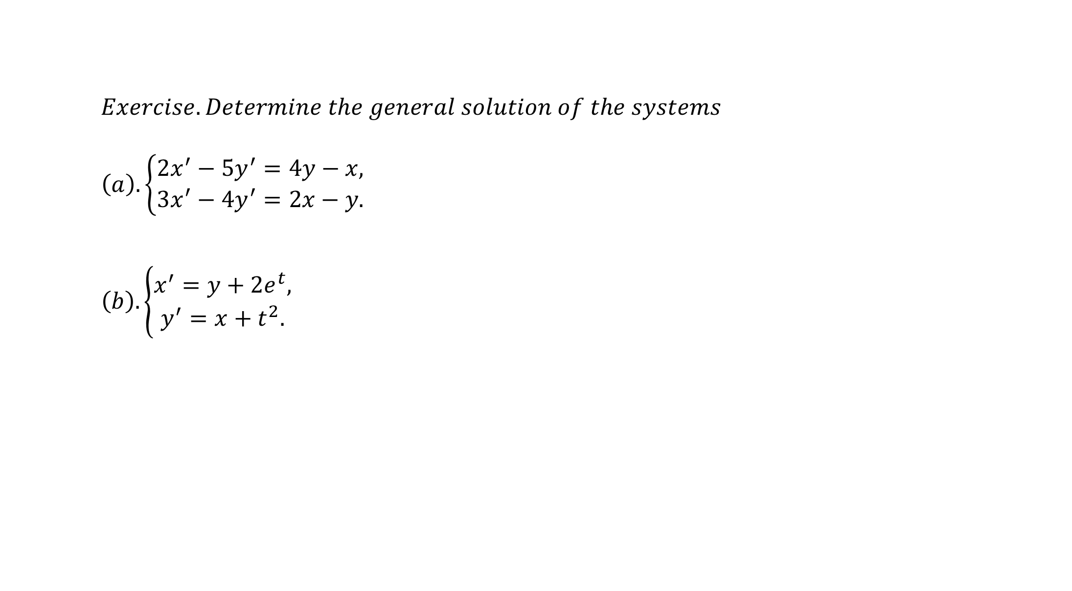
$$Exercise. Determine the general solution of the systems \\ \left(a\right).\left\{\begin{aligned}2x^{′}−5y^{′}=4y−x, \\ 3x^{′}−4y^{′}=2x−y.\end{aligned}\right.$$
$$\left(b\right). \left\{\begin{aligned}x^{′}=y+2e^{t}, \\ y^{′}=x+t^{2}.\end{aligned}\right.$$

Slide 24
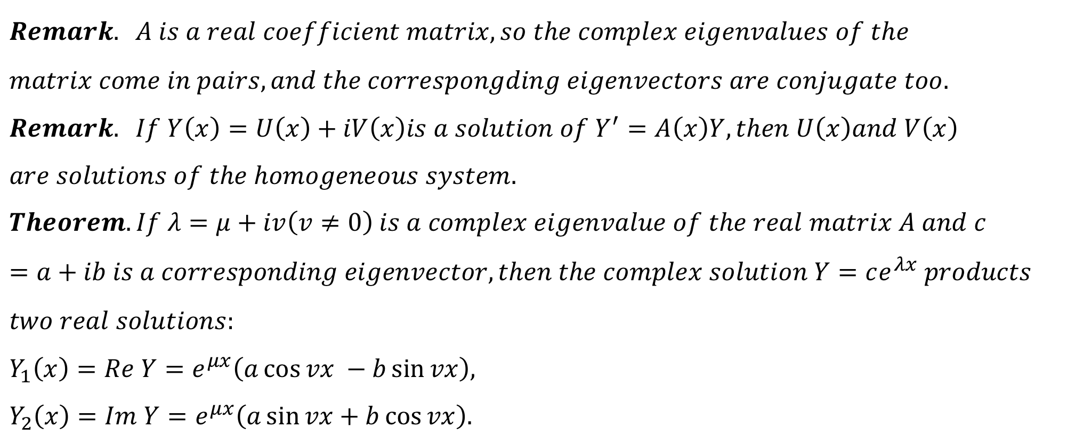
$$Remark. A is a real coefficient matrix, so the complex eigenvalues of the \\ matrix come in pairs, and the correspongding eigenvectors are conjugate too.$$
$$Remark. If Y\left(x\right)=U\left(x\right)+iV\left(x\right)is a solution of Y^{′}=A\left(x\right)Y, then U\left(x\right)and V\left(x\right) \\ are solutions of the homogeneous system. \\ Theorem. If λ=μ+iv\left(v≠0\right) is a complex eigenvalue of the real matrix A and c=a+ib is a corresponding eigenvector, then the complex solution Y=ce^{λx} products \\ two real solutions: \\ Y_{1}\left(x\right)=Re Y=e^{μx}\left(a\cos{vx }−b\sin{vx}\right), \\ Y_{2}\left(x\right)=Im Y=e^{μx}\left(a\sin{vx}+b\cos{vx}\right).$$

Slide 25
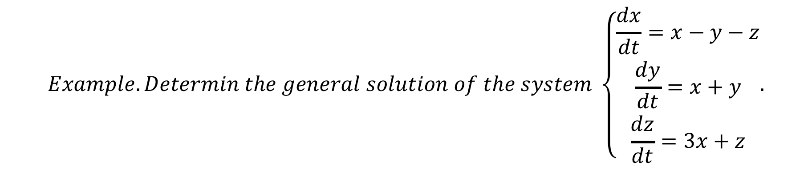
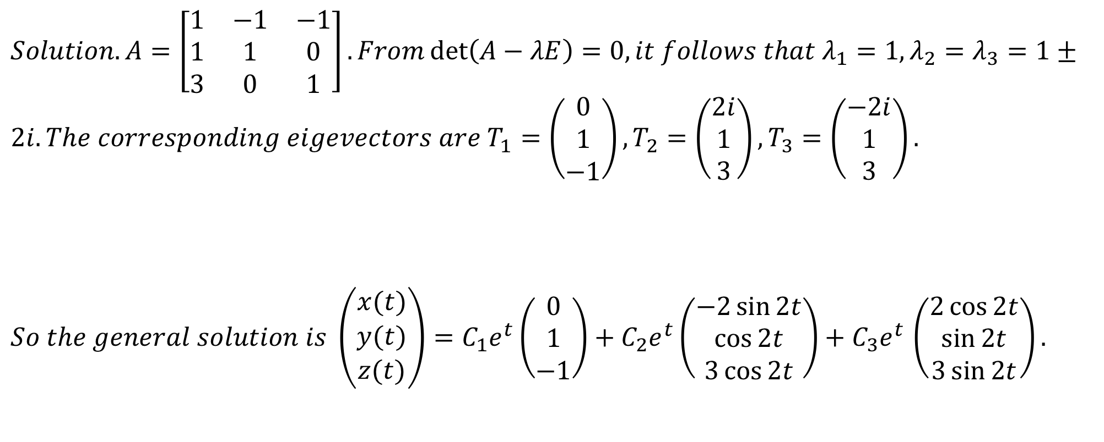
$$Example. Determin the general solution of the system \left\{\begin{matrix}\frac{dx}{dt}=x−y−z \\ \frac{dy}{dt}=x+y \\ \frac{dz}{dt}=3x+z\end{matrix}.\right.$$
$$Solution. A=\left[\begin{matrix}1 & −1 & −1 \\ 1 & 1 & 0 \\ 3 & 0 & 1\end{matrix}\right]. From\det\left(A−λE\right)=0, it follows that λ_{1}=1,λ_{2}=λ_{3}=1± \\ 2i. The corresponding eigevectors are T_{1}=\left(\begin{matrix}0 \\ 1 \\ −1\end{matrix}\right),T_{2}=\left(\begin{matrix}2i \\ 1 \\ 3\end{matrix}\right),T_{3}=\left(\begin{matrix}−2i \\ 1 \\ 3\end{matrix}\right).$$
$So the general solution is \left(\begin{matrix}x(t) \\ y(t) \\ z(t)\end{matrix}\right)=C_{1}e^{t}\left(\begin{matrix}0 \\ 1 \\ −1\end{matrix}\right)+C_{2}e^{t}\left(\begin{matrix}−2\sin{2t} \\ \cos{2t} \\ 3\cos{2t}\end{matrix}\right)+C_{3}e^{t}$ $\left(\begin{matrix}2\cos{2t} \\ \sin{2t} \\ 3\sin{2t}\end{matrix}\right).$

Slide 26
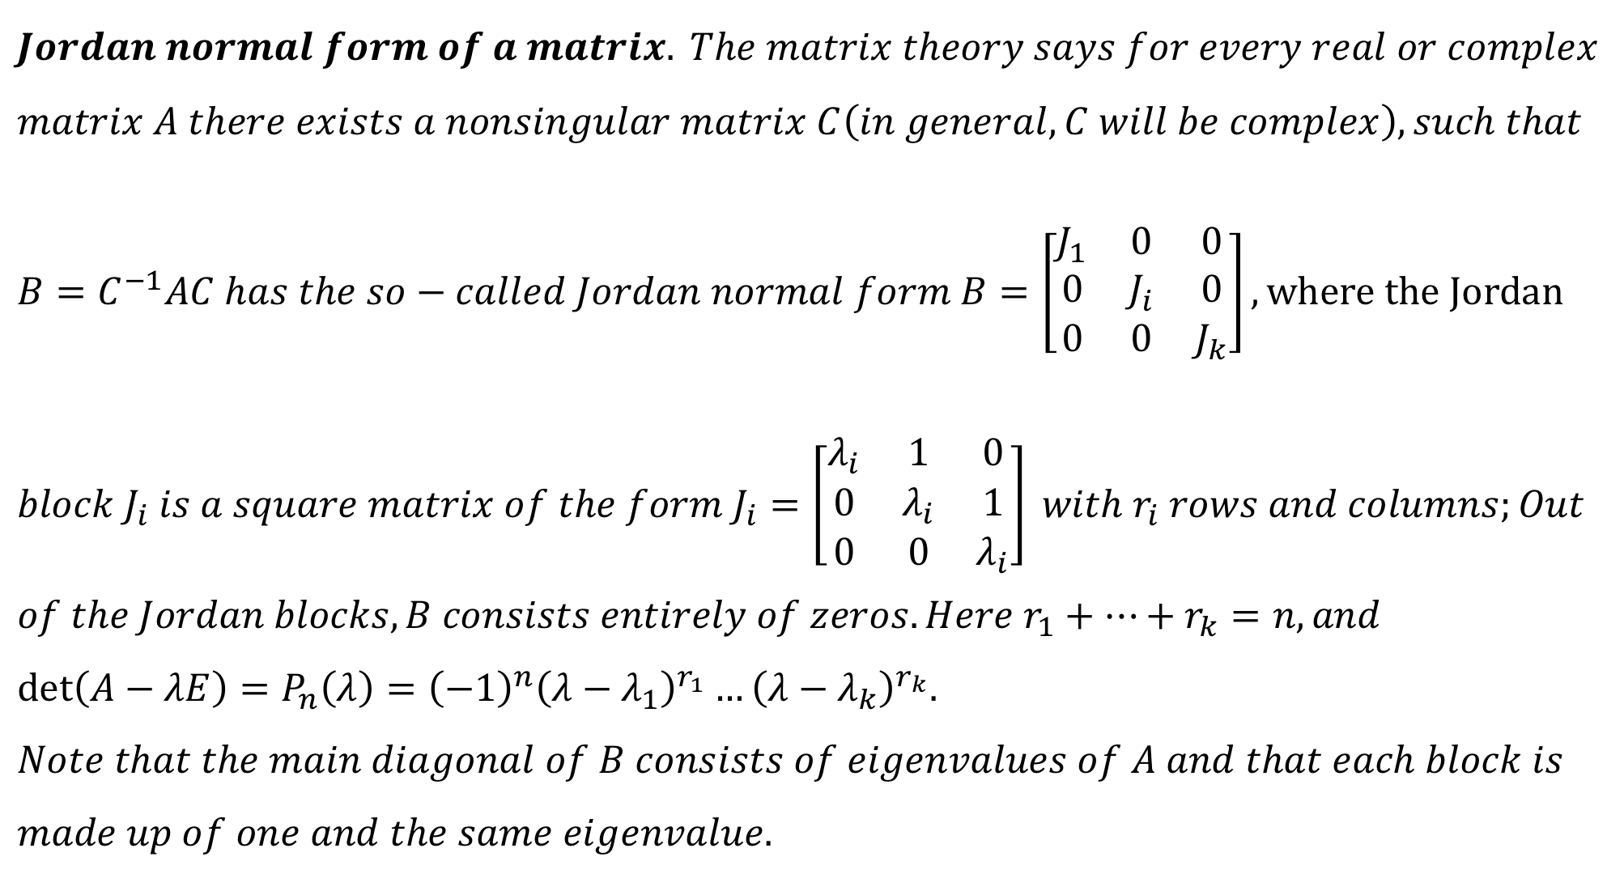
$$Jordan normal form of a matrix. The matrix theory says for every real or complex \\ matrix A there exists a nonsingular matrix C\left(in general, C will be complex\right),such that \\ B=C^{−1}AC has the so−called Jordan normal form B=\left[\begin{matrix}J_{1} & 0 & 0 \\ 0 & J_{i} & 0 \\ 0 & 0 & J_{k}\end{matrix}\right], where the Jordan \\ block J_{i} is a square matrix of the form J_{i}=\left[\begin{matrix}λ_{i} & 1 & 0 \\ 0 & λ_{i} & 1 \\ 0 & 0 & λ_{i}\end{matrix}\right] with r_{i} rows and columns;Out \\ of the Jordan blocks, B consists entirely of zeros. Here r_{1}+…+r_{k}=n, and \\ \det\left(A−λE\right)=P_{n}\left(λ\right)={\left(−1\right)}^{n}{\left(λ−λ_{1}\right)}^{r_{1}}…{\left(λ−λ_{k}\right)}^{r_{k}}. \\ Note that the main diagonal of B consists of eigenvalues of A and that each block is \\ made up of one and the same eigenvalue.$$

Slide 27
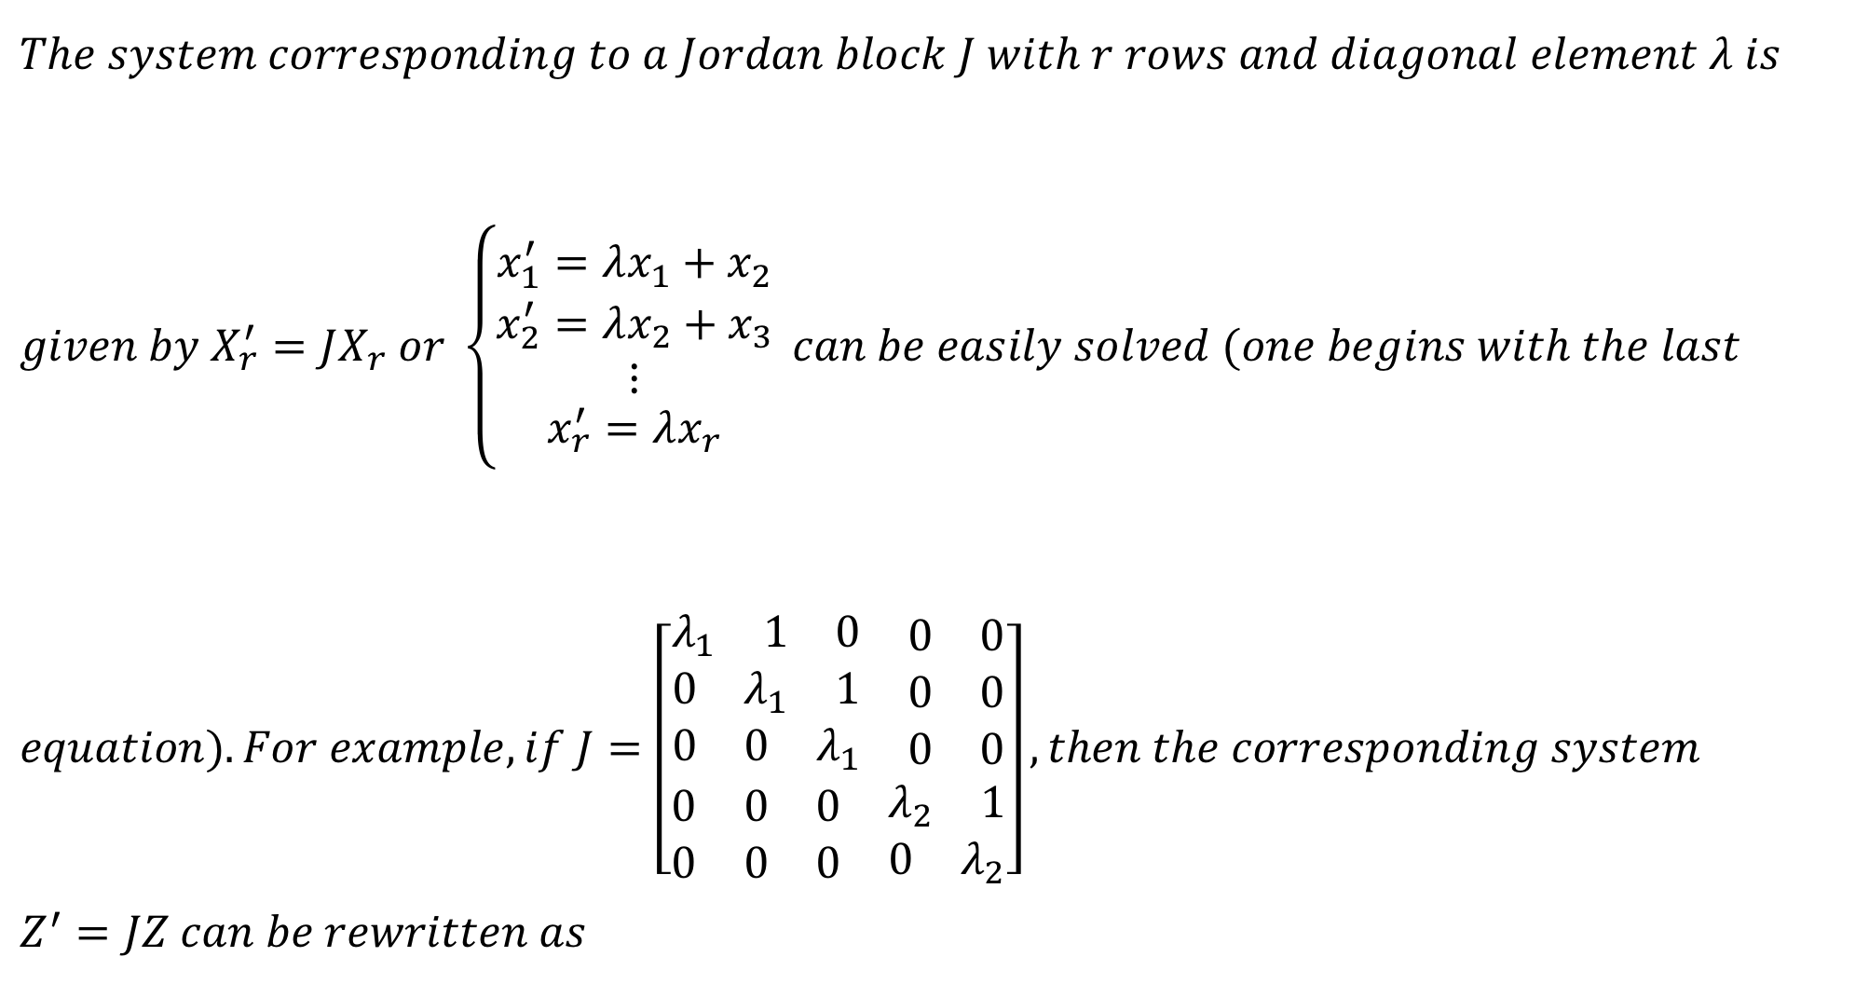
$$The system corresponding to a Jordan block J with r rows and diagonal element λ is \\ given by X_{r}^{′}=JX_{r} or \left\{\begin{matrix}x_{1}^{′}=λx_{1}+x_{2} \\ \begin{matrix}x_{2}^{′}=λx_{2}+x_{3} \\ ⋮\end{matrix} \\ x_{r}^{′}=λx_{r}\end{matrix}\right. can be easily solved (one begins with the last \\ equation). For example, if J=\left[\begin{aligned}\begin{matrix}\begin{matrix}λ_{1} & 1 & 0\end{matrix} & \begin{matrix}0 & 0\end{matrix} \\ \begin{matrix}0 & λ_{1} & 1\end{matrix} & \begin{matrix}0 & 0\end{matrix}\end{matrix} \\ \begin{matrix}\begin{matrix}0 & 0 & λ_{1}\end{matrix} & \begin{matrix}0 & 0\end{matrix}\end{matrix} \\ \begin{matrix}\begin{matrix}0 & 0 & 0\end{matrix} & \begin{matrix}λ_{2} & 1\end{matrix}\end{matrix} \\ \begin{matrix}\begin{matrix}0 & 0 & 0\end{matrix} & \begin{matrix}0 & λ_{2}\end{matrix}\end{matrix}\end{aligned}\right],then the corresponding system \\ Z^{′}=JZ can be rewritten as$$

Slide 28
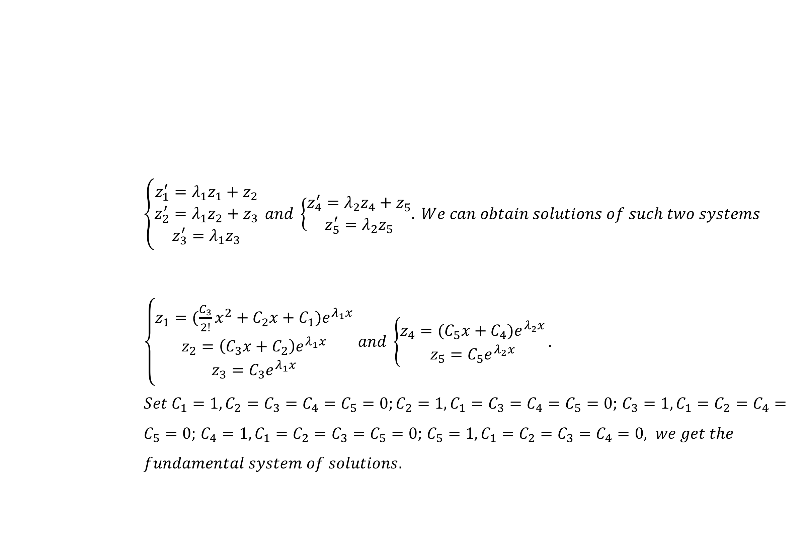
$$\left\{\begin{matrix}z_{1}^{′}=λ_{1}z_{1}+z_{2} \\ z_{2}^{′}=λ_{1}z_{2}+z_{3} \\ z_{3}^{′}=λ_{1}z_{3}\end{matrix}\right. and \left\{\begin{matrix}z_{4}^{′}=λ_{2}z_{4}+z_{5} \\ z_{5}^{′}=λ_{2}z_{5}\end{matrix}.\right. We can obtain solutions of such two systems$$ $\left\{\begin{matrix}z_{1}=(\frac{C_{3}}{2!}x^{2}+C_{2}x+C_{1})e^{λ_{1}x} \\ z_{2}=\left(C_{3}x+C_{2}\right)e^{λ_{1}x} \\ z_{3}=C_{3}e^{λ_{1}x}\end{matrix}\right.$ $and \left\{\begin{matrix}z_{4}=(C_{5}x+C_{4})e^{λ_{2}x} \\ z_{5}=C_{5}e^{λ_{2}x}\end{matrix}\right..$ $Set C_{1}=1, C_{2}=C_{3}=C_{4}=C_{5}=0;C_{2}=1, C_{1}=C_{3}=C_{4}=C_{5}=0;$ $C_{3}=1, C_{1}=C_{2}=C_{4}=C_{5}=0;$ $C_{4}=1, C_{1}=C_{2}=C_{3}=C_{5}=0;$ $C_{5}=1, {C_{1}=C}_{2}=C_{3}=C_{4}=0, we get the$ $$fundamental system of solutions.$$

Slide 29
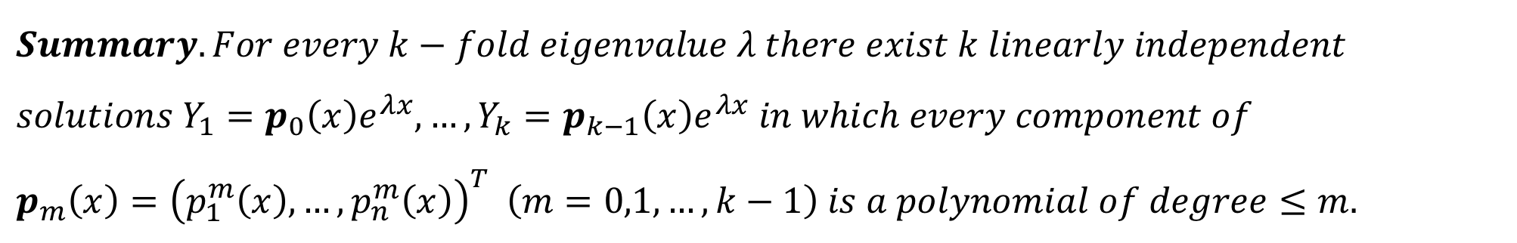
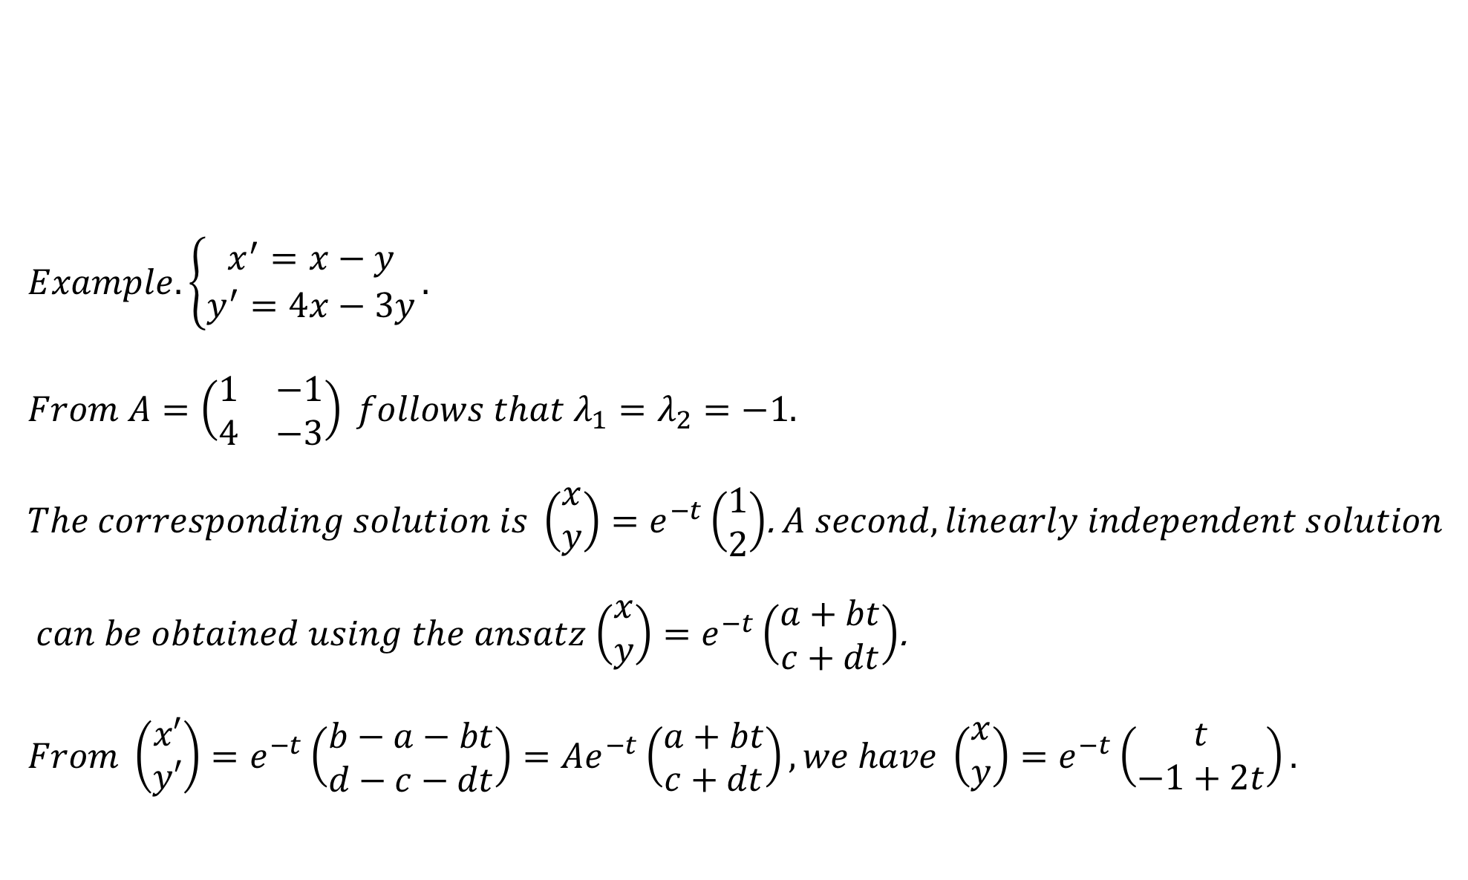
$$Summary.For every k−fold eigenvalue λ there exist k linearly independent \\ solutions Y_{1}=p_{0}\left(x\right)e^{λx},…,Y_{k}=p_{k−1}\left(x\right)e^{λx} in which every component of$$
$$p_{m}\left(x\right)={\left(p_{1}^{m}\left(x\right),…,p_{n}^{m}\left(x\right)\right)}^{T} \left(m=0,1,…,k−1\right) is a polynomial of degree≤m.$$
$$Example. \left\{\begin{aligned}x^{′}=x−y \\ y^{′}=4x−3y\end{aligned}\right..$$
$$From A=\left(\begin{matrix}1 & −1 \\ 4 & −3\end{matrix}\right) follows that λ_{1}=λ_{2}=−1.$$
$The corresponding solution is \left(\begin{matrix}x \\ y\end{matrix}\right)=e^{−t}\left(\begin{matrix}1 \\ 2\end{matrix}\right)$. $A second, linearly independent solution$
$can be obtained using the ansatz$ $\left(\begin{matrix}x \\ y\end{matrix}\right)=e^{−t}\left(\begin{matrix}a+bt \\ c+dt\end{matrix}\right)$.
$$From \left(\begin{matrix}x′ \\ y′\end{matrix}\right)=e^{−t}\left(\begin{matrix}b−a−bt \\ d−c−dt\end{matrix}\right)=Ae^{−t}\left(\begin{matrix}a+bt \\ c+dt\end{matrix}\right), we have \left(\begin{matrix}x \\ y\end{matrix}\right)=e^{−t}\left(\begin{matrix}t \\ −1+2t\end{matrix}\right).$$

Slide 30
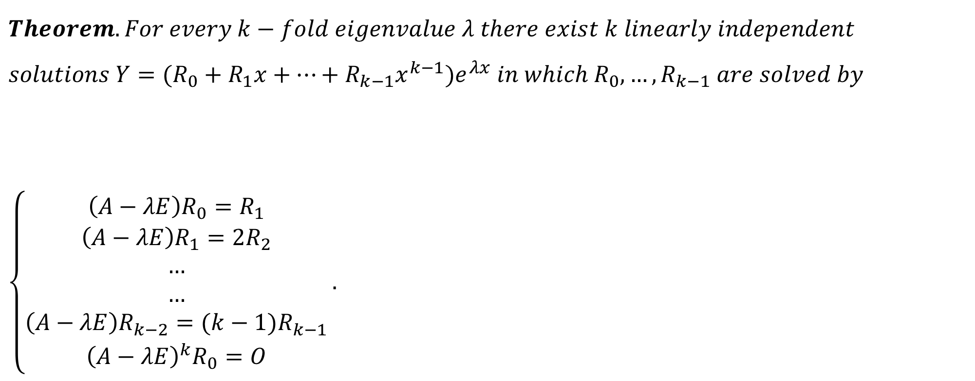
$$Theorem.For every k−fold eigenvalue λ there exist k linearly independent \\ solutions Y=(R_{0}+R_{1}x+…+R_{k−1}x^{k−1}{)e}^{λx} in which R_{0},…,R_{k−1} are solved by \\ \left\{\begin{aligned}\left(A−λE\right)R_{0}=R_{1} \\ \left(A−λE\right)R_{1}={2R}_{2} \\ … \\ … \\ \left(A−λE\right)R_{k−2}={(k−1)R}_{k−1} \\ {\left(A−λE\right)}^{k}R_{0}=O\end{aligned}\right..$$

Slide 31
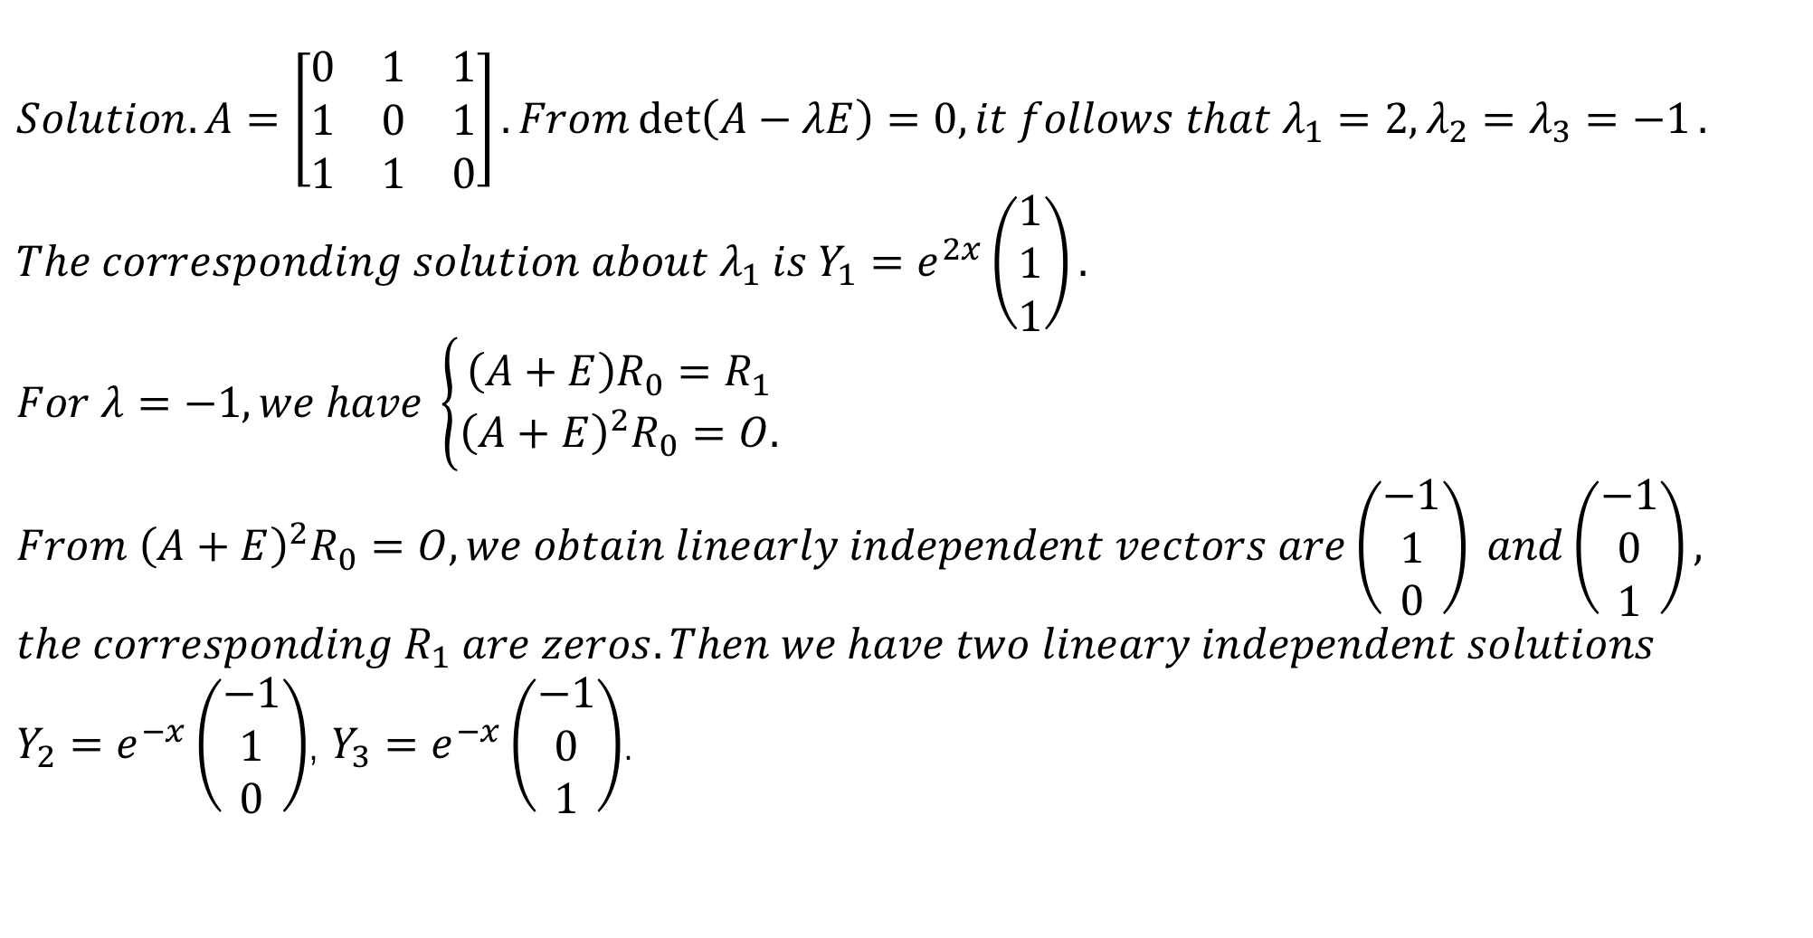
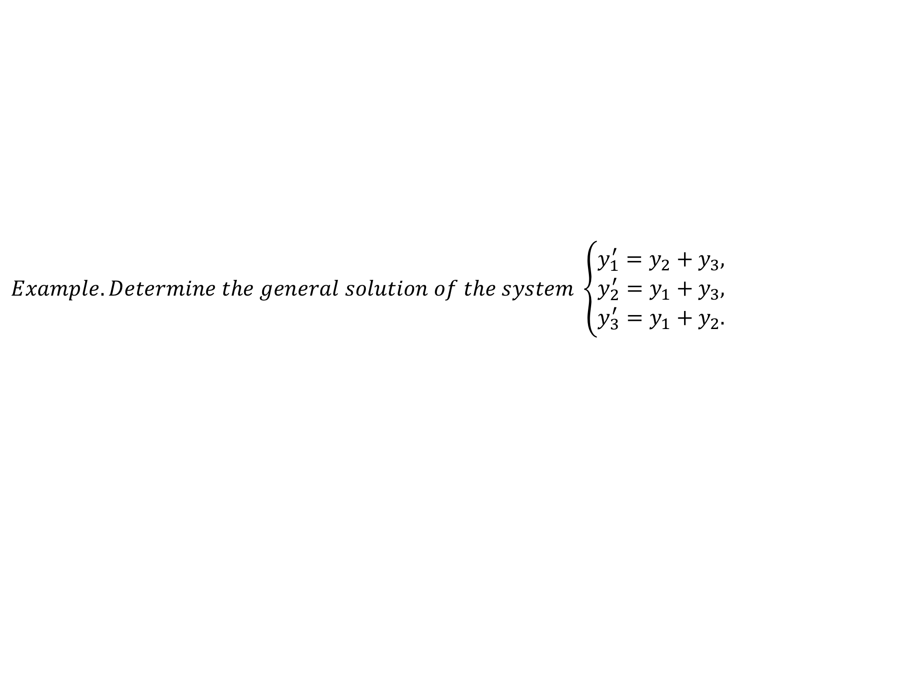
$$Example. Determine the general solution of the system \left\{\begin{aligned}y_{1}^{′}=y_{2}+y_{3}, \\ y_{2}^{′}=y_{1}+y_{3}, \\ y_{3}^{′}=y_{1}+y_{2}.\end{aligned}\right.$$
$$Solution. A=\left[\begin{matrix}0 & 1 & 1 \\ 1 & 0 & 1 \\ 1 & 1 & 0\end{matrix}\right]. From\det\left(A−λE\right)=0, it follows that λ_{1}=2,λ_{2}=λ_{3}=−1.$$
$$The corresponding solution about λ_{1} is Y_{1}=e^{2x}\left(\begin{matrix}1 \\ 1 \\ 1\end{matrix}\right).$$
$$For λ=−1, we have \left\{\begin{aligned}\left(A+E\right)R_{0}=R_{1} \\ {\left(A+E\right)}^{2}R_{0}=O.\end{aligned}\right.$$
$$From {\left(A+E\right)}^{2}R_{0}=O, we obtain linearly independent vectors are\left(\begin{matrix}−1 \\ 1 \\ 0\end{matrix}\right) and\left(\begin{matrix}−1 \\ 0 \\ 1\end{matrix}\right), \\ the corresponding R_{1} are zeros.Then we have two lineary independent solutions$$
$Y_{2}=e^{−x}\left(\begin{matrix}−1 \\ 1 \\ 0\end{matrix}\right)$, $Y_{3}=e^{−x}\left(\begin{matrix}−1 \\ 0 \\ 1\end{matrix}\right)$.

Slide 32
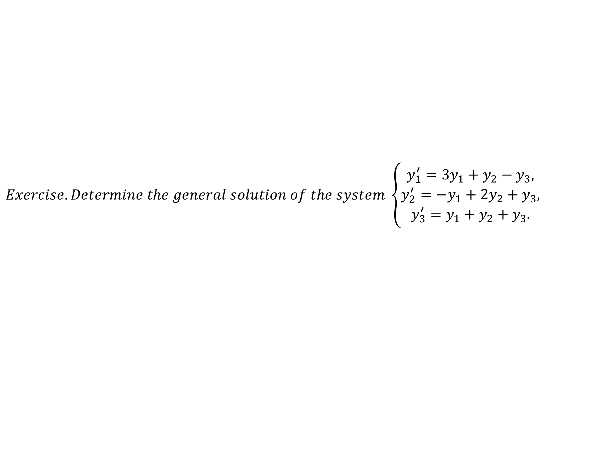
$$Exercise. Determine the general solution of the system \left\{\begin{aligned}y_{1}^{′}=3y_{1}+y_{2}−y_{3}, \\ y_{2}^{′}=−y_{1}+2y_{2}+y_{3}, \\ y_{3}^{′}=y_{1}+y_{2}+y_{3}.\end{aligned}\right.$$

Slide 33
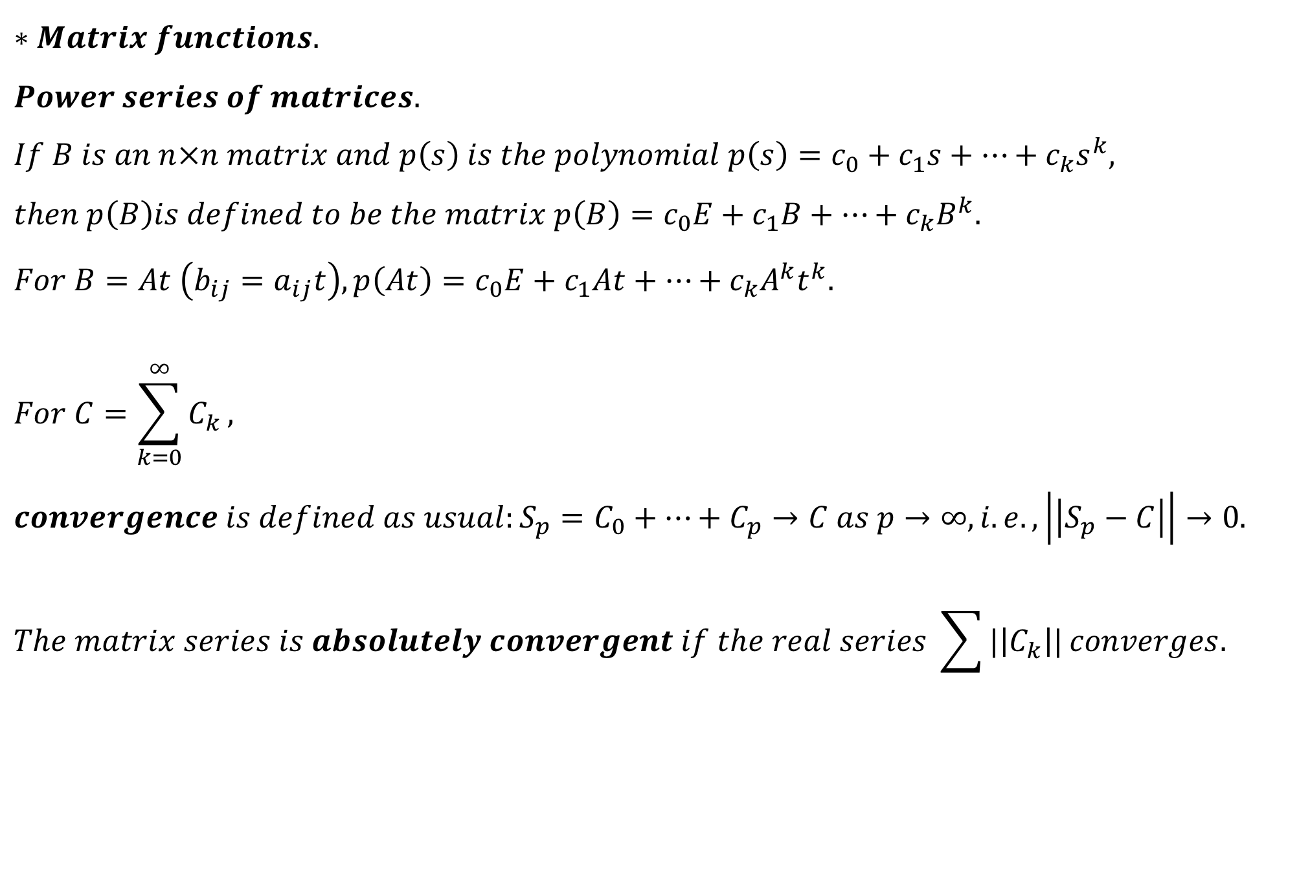
$$∗Matrix functions. \\ Power series of matrices. \\ If B is an n×n matrix and p\left(s\right) is the polynomial p\left(s\right)=c_{0}+c_{1}s+…+c_{k}s^{k}, \\ then p\left(B\right)is defined to be the matrix p\left(B\right)=c_{0}E+c_{1}B+…+c_{k}B^{k}. \\ For B=At \left(b_{ij}=a_{ij}t\right), p\left(At\right)=c_{0}E+c_{1}At+…+c_{k}A^{k}t^{k}. \\ For C=\sum_{k=0}^{∞}{C_{k}},$$
$$convergence is defined as usual:S_{p}=C_{0}+…+C_{p}→C as p→∞,i.e.,\left|\left|S_{p}−C\right|\right|→0.$$
$$The matrix series is absolutely convergent if the real series \sum{|\left|C_{k}\right||}converges.$$

Slide 34
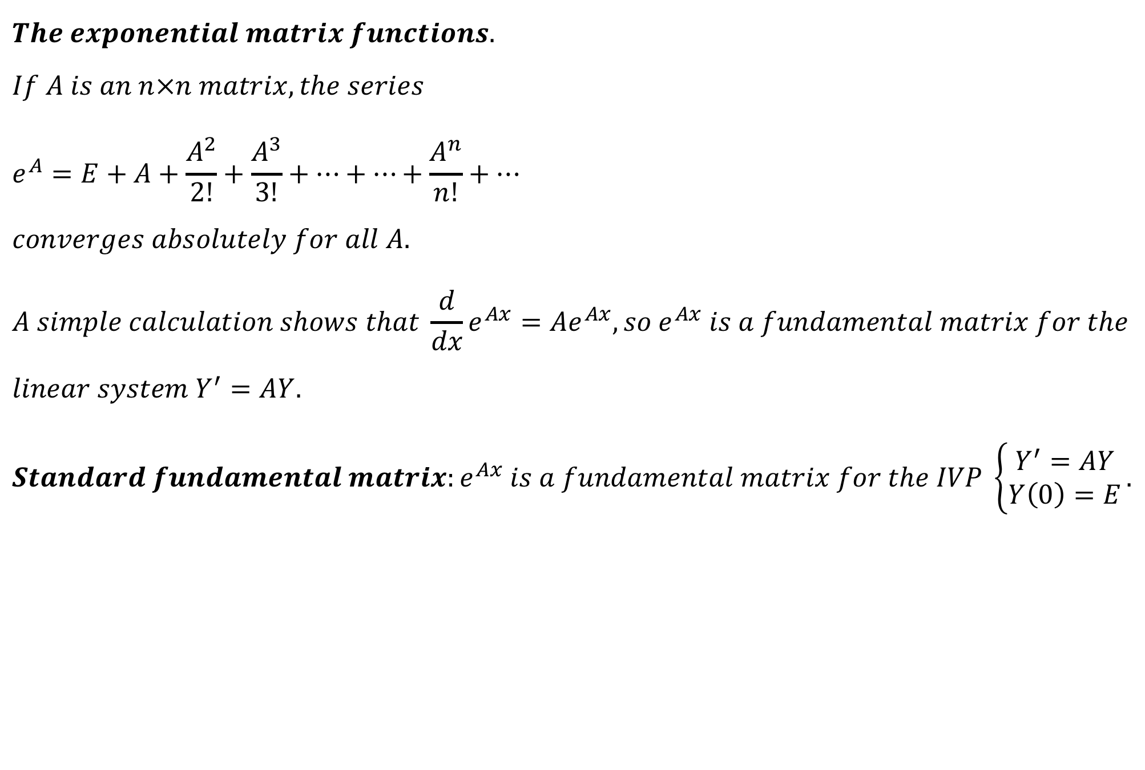
$$The exponential matrix functions. \\ If A is an n×n matrix, the series \\ e^{A}=E+A+\frac{A^{2}}{2!}+\frac{A^{3}}{3!}+…+…+\frac{A^{n}}{n!}+… \\ converges absolutely for all A. \\ A simple calculation shows that \frac{d}{dx}e^{Ax}=Ae^{Ax}, so e^{Ax} is a fundamental matrix for the \\ linear system Y^{′}=AY. \\ Standard fundamental matrix:e^{Ax} is a fundamental matrix for the IVP \left\{\begin{aligned}Y^{′}=AY \\ Y\left(0\right)=E\end{aligned}\right..$$

Slide 35
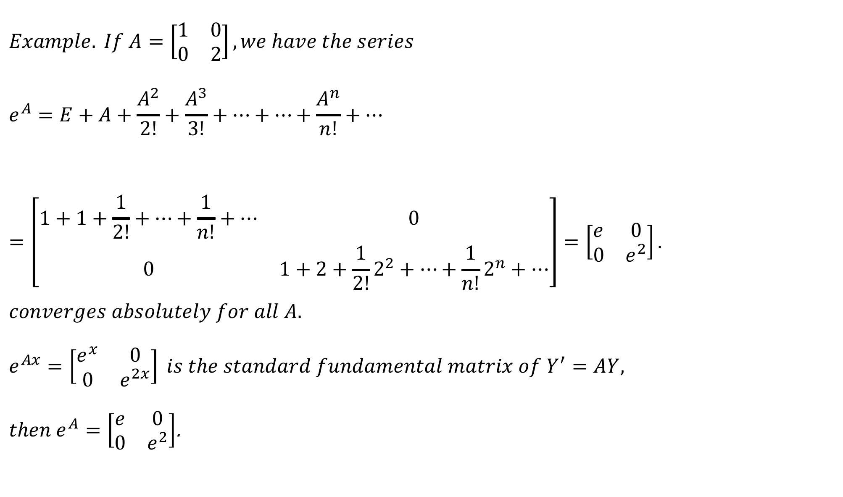
$$Example. If A=\left[\begin{matrix}1 & 0 \\ 0 & 2\end{matrix}\right], we have the series \\ e^{A}=E+A+\frac{A^{2}}{2!}+\frac{A^{3}}{3!}+…+…+\frac{A^{n}}{n!}+…=\left[\begin{matrix}1+1+\frac{1}{2!}+…+\frac{1}{n!}+… & 0 \\ 0 & 1+2+\frac{1}{2!}2^{2}+…+\frac{1}{n!}2^{n}+…\end{matrix}\right]=\left[\begin{matrix}e & 0 \\ 0 & e^{2}\end{matrix}\right]. \\ converges absolutely for all A. \\ e^{Ax}=\left[\begin{matrix}e^{x} & 0 \\ 0 & e^{2x}\end{matrix}\right] is the standard fundamental matrix of Y^{′}=AY,$$ $then e^{A}=\left[\begin{matrix}e & 0 \\ 0 & e^{2}\end{matrix}\right]$.

Slide 36
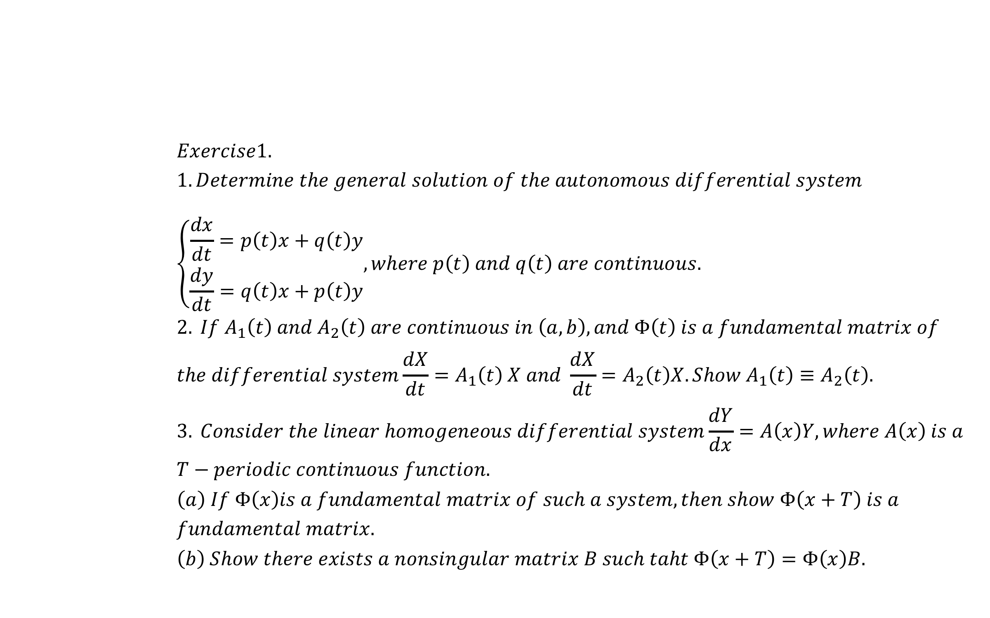
$$Exercise1. \\ 1. Determine the general solution of the autonomous differential system \\ \left\{\begin{matrix}\frac{dx}{dt}=p\left(t\right)x+q\left(t\right)y \\ \frac{dy}{dt}=q\left(t\right)x+p\left(t\right)y\end{matrix}, where p\left(t\right) and q\left(t\right) are continuous.\right. \\ 2. If A_{1}\left(t\right) and A_{2}\left(t\right) are continuous in \left(a,b\right), and Φ\left(t\right) is a fundamental matrix of \\ the differential system\frac{dX}{dt}=A_{1}\left(t\right) X and \frac{dX}{dt}=A_{2}\left(t\right)X. Show A_{1}\left(t\right)≡A_{2}\left(t\right). \\ 3. Consider the linear homogeneous differential system\frac{dY}{dx}=A\left(x\right)Y, where A\left(x\right) is a \\ T−periodic continuous function. \\ \left(a\right) If Φ\left(x\right)is a fundamental matrix of such a system, then show Φ\left(x+T\right) is a \\ fundamental matrix. \\ \left(b\right) Show there exists a nonsingular matrix B such taht Φ\left(x+T\right)=Φ\left(x\right)B.$$

Slide 37
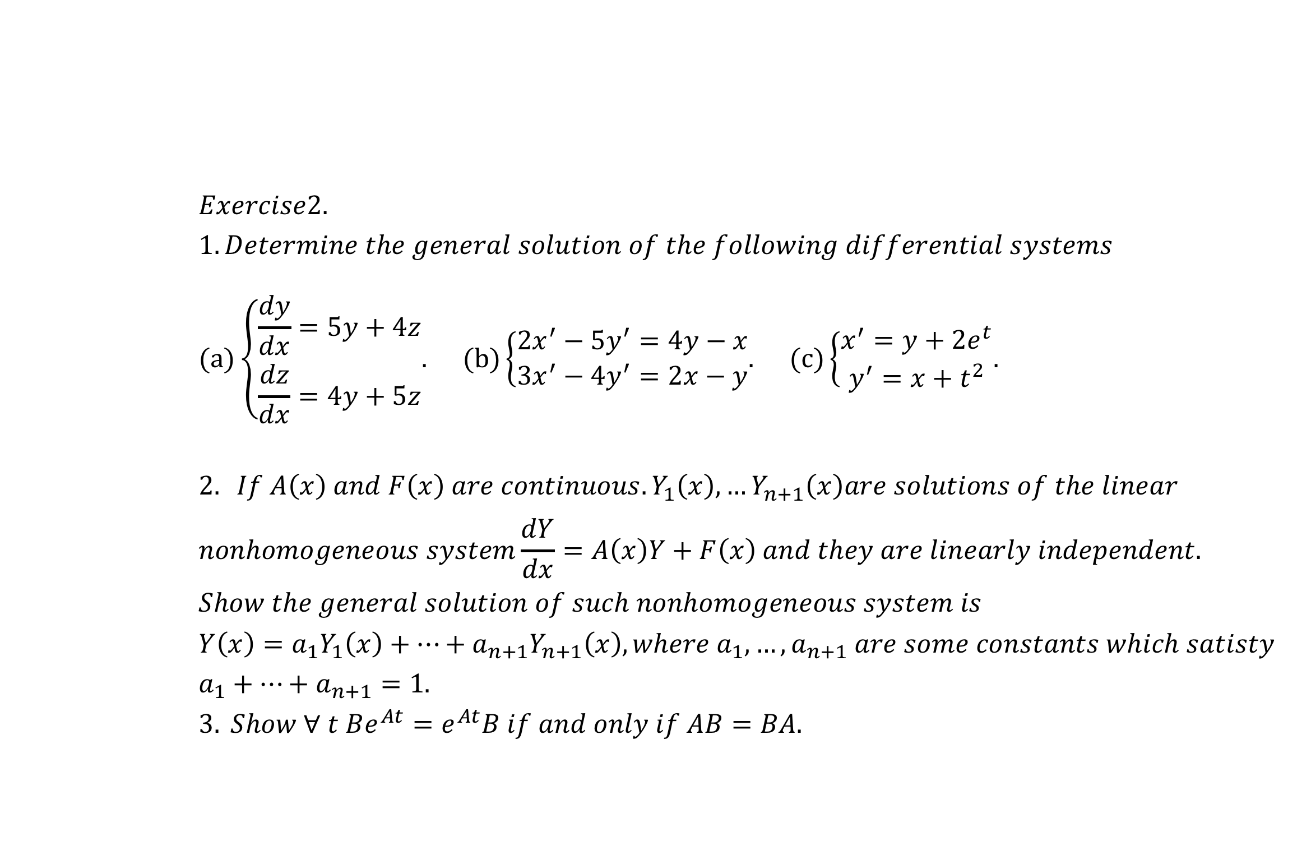
$$Exercise2. \\ 1. Determine the general solution of the following differential systems \\ (a)\left\{\begin{matrix}\frac{dy}{dx}=5y+4z \\ \frac{dz}{dx}=4y+5z\end{matrix}. \right.(b)\left\{\begin{matrix}2x^{′}−5y^{′}=4y−x \\ 3x^{′}−4y^{′}=2x−y\end{matrix}. \right.(c)\left\{\begin{matrix}x^{′}=y+2e^{t} \\ y^{′}=x+t^{2}\end{matrix}. \right.$$
$$2. If A\left(x\right) and F\left(x\right) are continuous. Y_{1}\left(x\right),…Y_{n+1}\left(x\right)are solutions of the linear \\ nonhomogeneous system\frac{dY}{dx}=A\left(x\right)Y+F\left(x\right) and they are linearly independent. \\ Show the general solution of such nonhomogeneous system is \\ Y\left(x\right)=a_{1}Y_{1}\left(x\right)+…+a_{n+1}Y_{n+1}\left(x\right), where a_{1},…,a_{n+1} are some constants which satisty \\ a_{1}+…+a_{n+1}=1.$$
$$3. Show ∀ t Be^{At}=e^{At}B if and only if AB=BA.$$

Slide 38
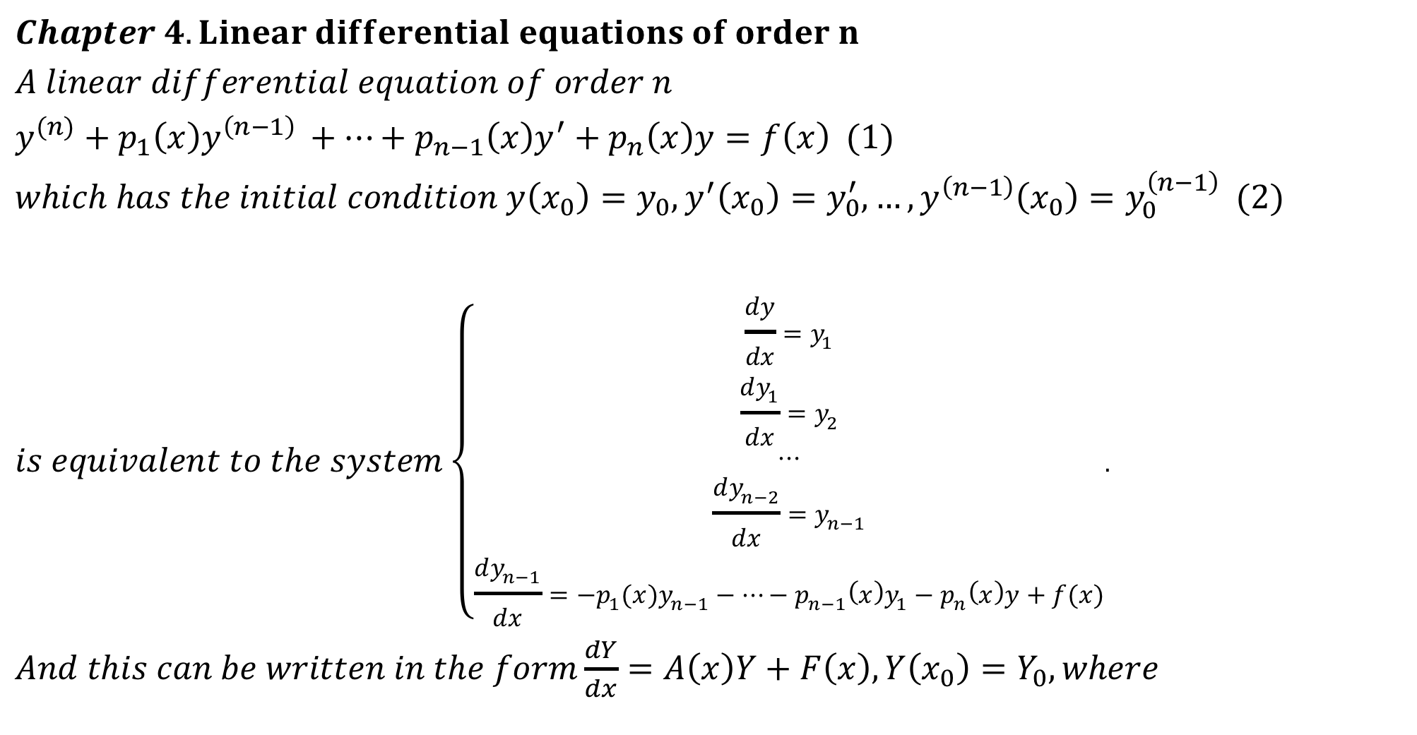
$$Chapter 4. Linear differential equations of order n \\ A linear differential equation of order n \\ y^{(n)}+p_{1}\left(x\right)y^{\left(n−1\right) }+…+p_{n−1}\left(x\right)y^{′}+p_{n}\left(x\right)y=f\left(x\right) (1) \\ which has the initial condition y\left(x_{0}\right)=y_{0},y^{′}\left(x_{0}\right)=y_{0}^{′},…,y^{\left(n−1\right)}\left(x_{0}\right)=y_{0}^{\left(n−1\right)} (2) \\ is equivalent to the system\left\{\begin{aligned}\frac{dy}{dx}=y_{1} \\ \frac{dy_{1}}{dx}=y_{2} \\ ⋯ \\ \frac{dy_{n−2}}{dx}=y_{n−1} \\ \frac{dy_{n−1}}{dx}={−p_{1}(x)y}_{n−1}−⋯−p_{n−1}\left(x\right)y_{1}−p_{n}\left(x\right)y+f(x)\end{aligned}.\right.$$
$And this can be written in the form\frac{dY}{dx}=A\left(x\right)Y+F\left(x\right), Y\left(x_{0}\right)=Y_{0}, where$

Slide 39
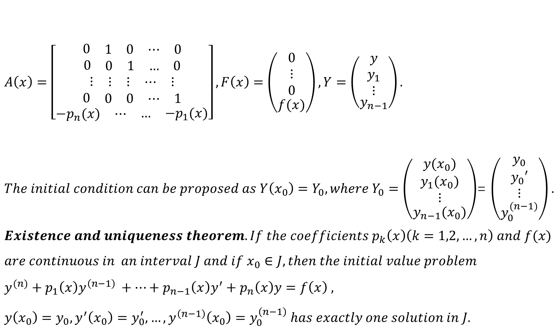
$A\left(x\right)=\left[\begin{aligned}\begin{matrix}0 & \begin{matrix}1 & 0\end{matrix} & \begin{matrix}⋯ & 0\end{matrix}\end{matrix} \\ \begin{matrix}0 & \begin{matrix}0 & 1\end{matrix} & \begin{matrix}… & 0\end{matrix}\end{matrix} \\ \begin{matrix}⋮ & \begin{matrix}⋮ & ⋮\end{matrix} & \begin{matrix}⋯ & ⋮\end{matrix}\end{matrix} \\ \begin{matrix}0 & \begin{matrix}0 & 0\end{matrix} & \begin{matrix}⋯ & 1\end{matrix}\end{matrix} \\ \begin{matrix}−p_{n}(x) & ⋯ & \begin{matrix}… & −p_{1}(x)\end{matrix}\end{matrix}\end{aligned}\right], F\left(x\right)=\left(\begin{matrix}\begin{matrix}0 \\ ⋮ \\ 0\end{matrix} \\ f(x)\end{matrix}\right),Y=$ $\left(\begin{matrix}\begin{matrix}y \\ y_{1} \\ ⋮\end{matrix} \\ y_{n−1}\end{matrix}\right).$ $The initial condition can be proposed as Y\left(x_{0}\right)=Y_{0}, where Y_{0}=$ $\left(\begin{matrix}\begin{matrix}y(x_{0}) \\ y_{1}(x_{0}) \\ ⋮\end{matrix} \\ y_{n−1}(x_{0})\end{matrix}\right)$= $\left(\begin{matrix}\begin{matrix}y_{0} \\ y_{0}′ \\ ⋮\end{matrix} \\ y_{0}^{(n−1)}\end{matrix}\right).$ $$Existence and uniqueness theorem. If the coefficients p_{k}\left(x\right)\left(k=1,2,…,n\right) and f(x) \\ are continuous in an interval J and if x_{0}∈J, then the initial value problem \\ y^{(n)}+p_{1}\left(x\right)y^{\left(n−1\right) }+…+p_{n−1}\left(x\right)y^{′}+p_{n}\left(x\right)y=f\left(x\right) , \\ y\left(x_{0}\right)=y_{0},y^{′}\left(x_{0}\right)=y_{0}^{′},…,y^{\left(n−1\right)}\left(x_{0}\right)=y_{0}^{\left(n−1\right)} has exactly one solution in J.$$

Slide 40
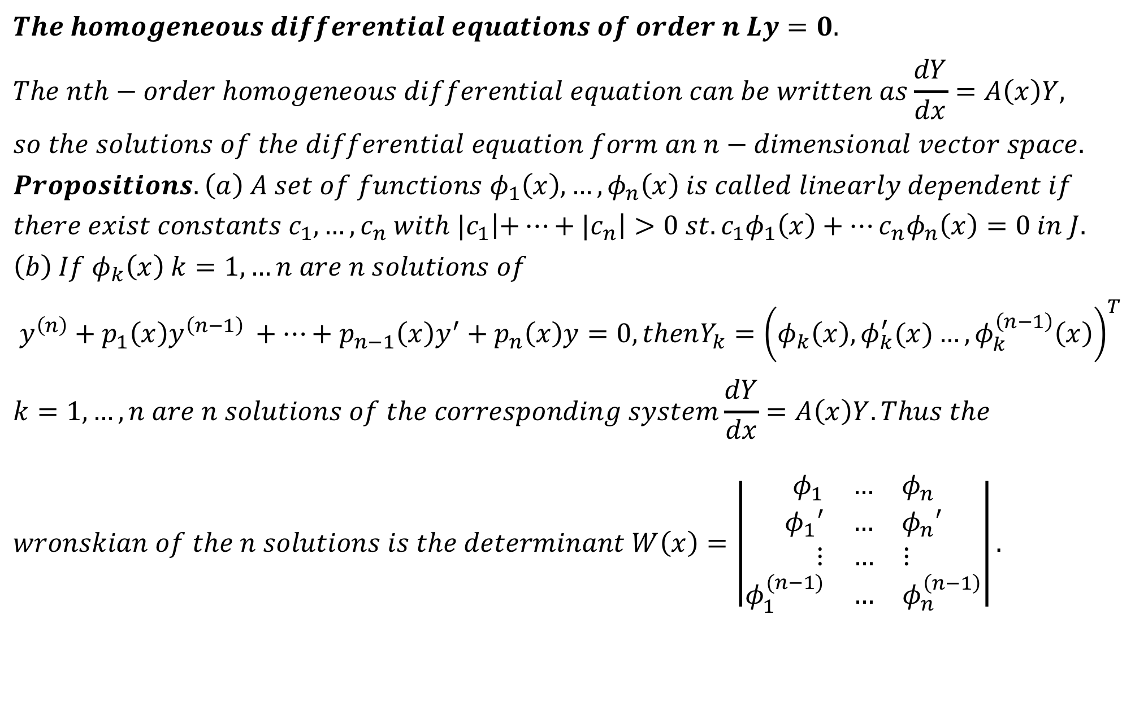
$$The homogeneous differential equations of order n Ly=0.$$
$$The nth−order homogeneous differential equation can be written as\frac{dY}{dx}=A\left(x\right)Y, \\ so the solutions of the differential equation form an n−dimensional vector space. \\ Propositions. \left(a\right) A set of functions φ_{1}\left(x\right),…,φ_{n}\left(x\right) is called linearly dependent if \\ there exist constants c_{1},…,c_{n} with {|c}_{1}\left|+…+{|c}_{n}\right|>0 st. c_{1}φ_{1}\left(x\right)+…c_{n}φ_{n}\left(x\right)=0 in J. \\ \left(b\right) If φ_{k}\left(x\right) k=1,…n are n solutions of \\ y^{\left(n\right)}+p_{1}\left(x\right)y^{\left(n−1\right) }+…+p_{n−1}\left(x\right)y^{′}+p_{n}\left(x\right)y=0, thenY_{k}={\left(φ_{k}\left(x\right), φ_{k}^{′}(x)…,φ_{k}^{\left(n−1\right)}\left(x\right)\right)}^{T} \\ k=1,…,n are n solutions of the corresponding system\frac{dY}{dx}=A\left(x\right)Y. Thus the \\ wronskian of the n solutions is the determinant W\left(x\right)=\left|\begin{aligned}\begin{matrix}φ_{1} & … & φ_{n}\end{matrix} \\ \begin{matrix}φ_{1}′ & … & φ_{n}′\end{matrix} \\ \begin{matrix}⋮ & … & ⋮\end{matrix} \\ \begin{matrix}φ_{1}^{(n−1)} & … & φ_{n}^{\left(n−1\right)}\end{matrix}\end{aligned}\right|.$$

Slide 41
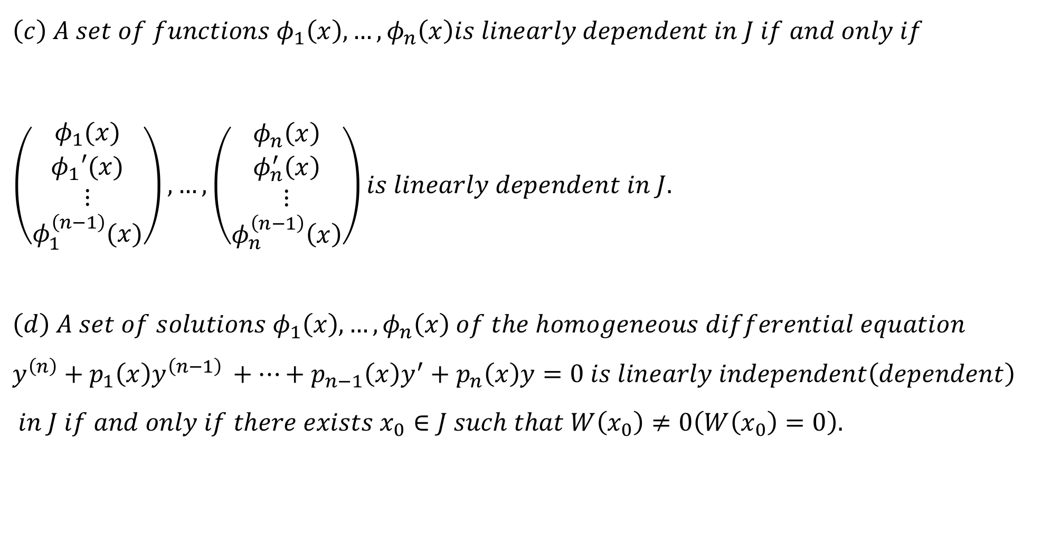
$$\left(c\right) A set of functions φ_{1}\left(x\right),…,φ_{n}\left(x\right)is linearly dependent in J if and only if \\ \left(\begin{matrix}\begin{matrix}φ_{1}(x) \\ φ_{1}′(x) \\ ⋮\end{matrix} \\ φ_{1}^{\left(n−1\right)}(x)\end{matrix}\right),…,\left(\begin{matrix}\begin{matrix}φ_{n}\left(x\right) \\ φ_{n}^{′}\left(x\right) \\ ⋮\end{matrix} \\ φ_{n}^{\left(n−1\right)}\left(x\right)\end{matrix}\right)is linearly dependent in J.$$
$$\left(d\right) A set of solutions φ_{1}\left(x\right),…,φ_{n}\left(x\right) of the homogeneous differential equation \\ y^{\left(n\right)}+p_{1}\left(x\right)y^{\left(n−1\right) }+…+p_{n−1}\left(x\right)y^{′}+p_{n}\left(x\right)y=0 is linearly independent\left(dependent\right)$$
$$in J if and only if there exists x_{0}∈J such that W\left(x_{0}\right)≠0\left(W\left(x_{0}\right)=0\right).$$

Slide 42
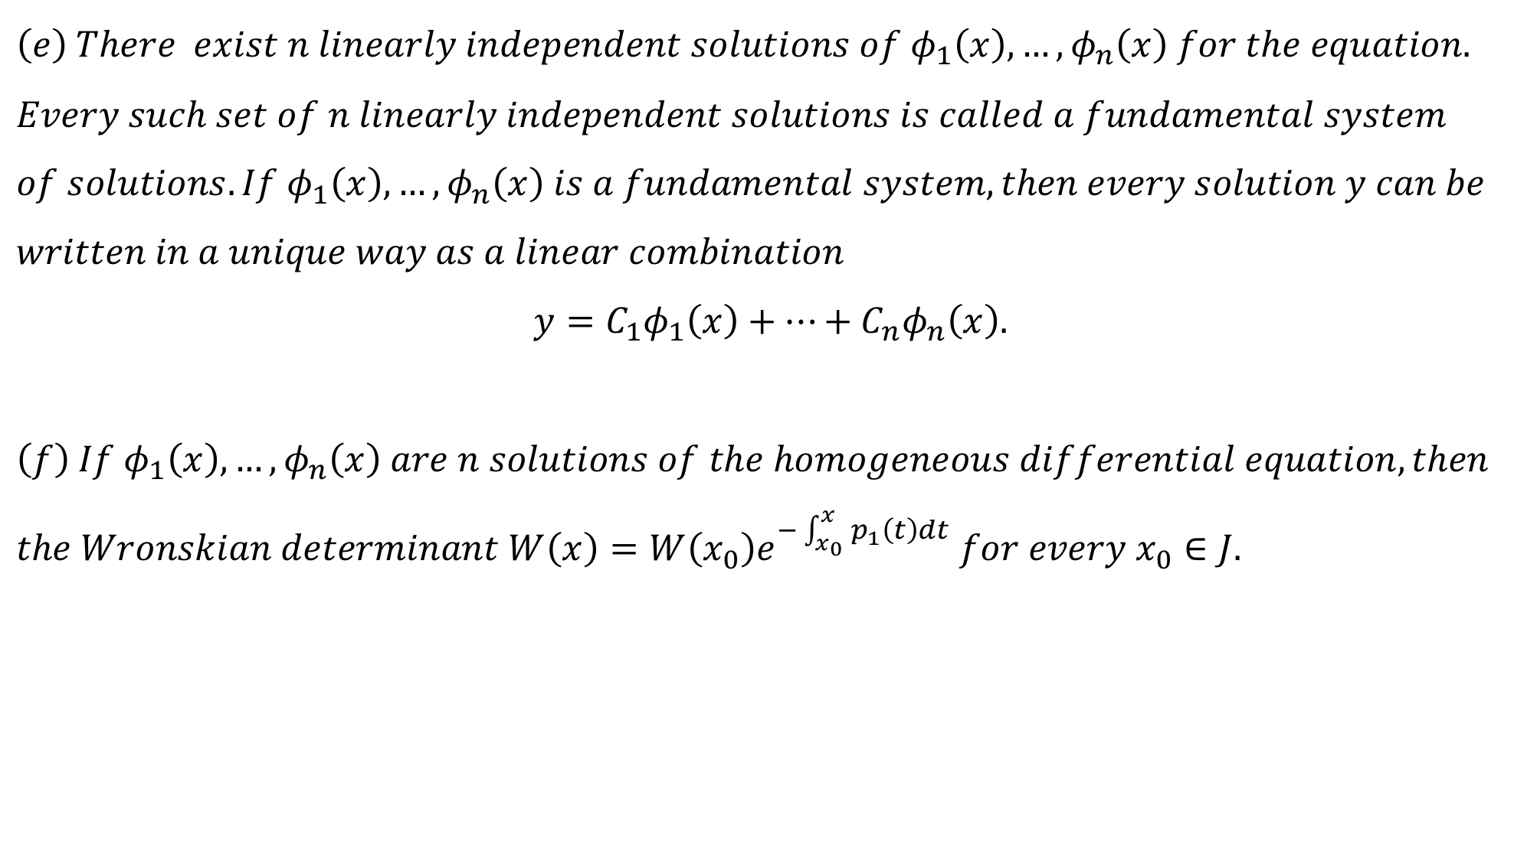
$$\left(e\right) There exist n linearly independent solutions of φ_{1}\left(x\right),…,φ_{n}\left(x\right) for the equation. \\ Every such set of n linearly independent solutions is called a fundamental system \\ of solutions. If φ_{1}\left(x\right),…,φ_{n}\left(x\right) is a fundamental system, then every solution y can be \\ written in a unique way as a linear combination$$
$$y=C_{1}φ_{1}\left(x\right)+…+C_{n}φ_{n}\left(x\right).$$
$$\left(f\right) If φ_{1}\left(x\right),…,φ_{n}\left(x\right) are n solutions of the homogeneous differential equation, then \\ the Wronskian determinant W\left(x\right)=W\left(x_{0}\right)e^{−\int_{x_{0}}^{x}{p_{1}\left(t\right)dt}} for every x_{0}∈J.$$

Slide 43
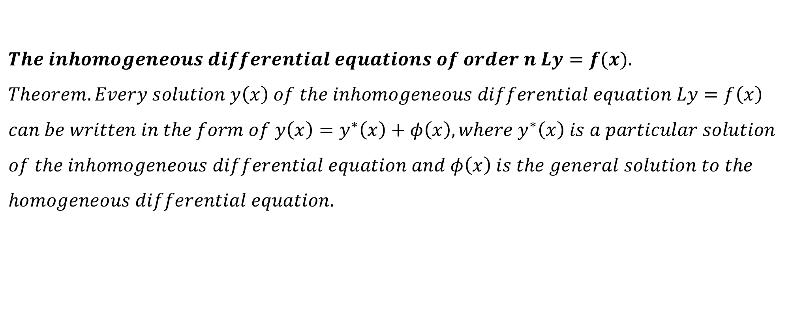
$$The inhomogeneous differential equations of order n Ly=f(x). \\ Theorem. Every solution y\left(x\right) of the inhomogeneous differential equation Ly=f\left(x\right) \\ can be written in the form of y\left(x\right)=y^{∗}\left(x\right)+φ\left(x\right), where y^{∗}\left(x\right) is a particular solution \\ of the inhomogeneous differential equation and φ\left(x\right) is the general solution to the \\ homogeneous differential equation.$$

Slide 44
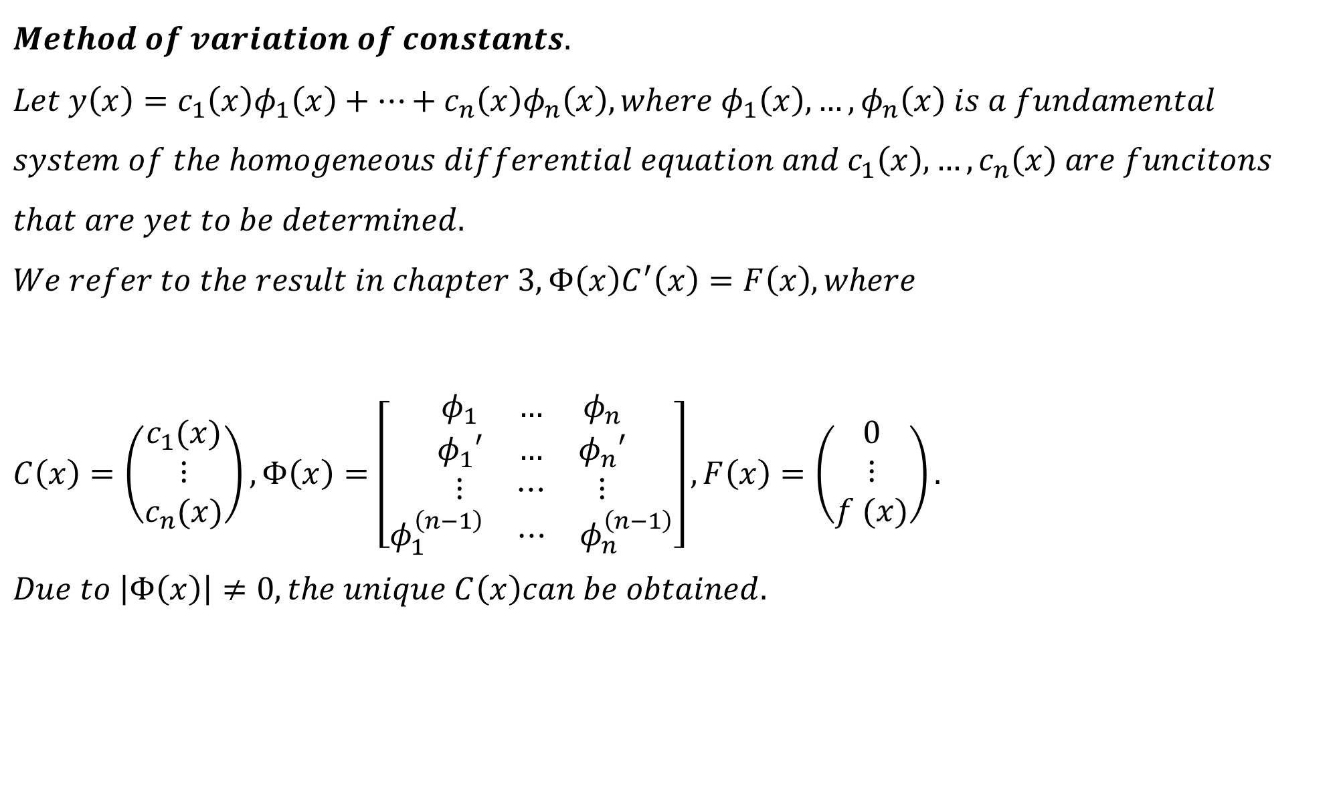
$$Method of variation of constants. \\ Let y\left(x\right)=c_{1}\left(x\right)φ_{1}\left(x\right)+…+c_{n}\left(x\right)φ_{n}\left(x\right), where φ_{1}\left(x\right),…,φ_{n}\left(x\right) is a fundamental \\ system of the homogeneous differential equation and c_{1}\left(x\right),…,c_{n}\left(x\right) are funcitons \\ that are yet to be determined. \\ We refer to the result in chapter 3, Φ\left(x\right)C^{′}\left(x\right)=F\left(x\right), where$$ $C\left(x\right)=\left(\begin{matrix}c_{1}(x) \\ ⋮ \\ c_{n}(x)\end{matrix}\right), Φ\left(x\right)=\left[\begin{aligned}\begin{matrix}φ_{1} & … & φ_{n} \\ φ_{1}′ & … & φ_{n}′ \\ ⋮ & ⋯ & ⋮\end{matrix} \\ \begin{matrix}φ_{1}^{\left(n−1\right)} & ⋯ & φ_{n}^{\left(n−1\right)}\end{matrix}\end{aligned}\right],F\left(x\right)=$ $\left(\begin{matrix}0 \\ ⋮ \\ f (x)\end{matrix}\right).$ $$Due to \left|Φ\left(x\right)\right|≠0, the unique C\left(x\right)can be obtained.$$

Slide 45

$$Example. y_{1}=\cos{x} and y_{2}=\sin{x are two solutions of y^{′′}+y}=0. \\ The corresponding Wronskian determinant is \left|\begin{matrix}y_{1} & y_{2} \\ y_{1}′ & y_{2}′\end{matrix}\right|=1≠0 in \left(−∞,+∞\right). \\ The general solution is y=C_{1}\cos{x}+C_{2}\sin{x}, where C_{1} and C_{2} are arbitrary constants. \\ Example. Determine the general solution of y^{′′}+y=\frac{1}{\cos{x}}. \\ Solution. The general solution of the related homogeneous differential equation is \\ y=c_{1}\cos{x}+c_{2}\sin{x}. \\ Set y_{1}=c_{1}\left(x\right)\cos{x}+c_{2}\left(x\right)\sin{x} is a special solution of the inhomogeneous differenti \\ al equation. So c_{1}^{′}\left(x\right) and c_{2}^{′}\left(x\right) satisfy the following system \\ \left(\begin{matrix}\cos{x} & \sin{x} \\ −\sin{x} & \cos{x}\end{matrix}\right)\left(\begin{matrix}c_{1}′(x) \\ c_{2}′(x)\end{matrix}\right)=\left(\begin{matrix}0 \\ \frac{1}{\cos{x}}\end{matrix}\right), then we have c_{1}^{′}\left(x\right)=−\frac{\sin{x}}{\cos{x}},c_{2}^{′}\left(x\right)=1. \\ By integrating, we obtain c_{1}\left(x\right)=\ln\left|\cos{x}\right|,c_{2}\left(x\right)=x. \\ Thus the general solution is y=c_{1}\cos{x}+c_{2}\sin{x}+\ln\left|\cos{x}\right|\cos{x}+x\sin{x}.$$

Slide 46

$$Linear equations of order n with constant coefficients. \\ Now let Ly=\sum_{i=0}^{n}{a_{i}y^{\left(i\right)}(x)}=0, a_{i} are constants, a_{n}=1 (1). \\ The characteristic polynomial is P\left(λ\right)=\sum_{i=0}^{n}{a_{i}λ^{i}}.$$
$$Theorem. If λ is a zero of the characteristic polynomial of multiplicity k, then there \\ are k solutions of the differential equation \left(1\right) e^{λx},xe^{λx},…,{x^{k−1}e}^{λx} that correspond \\ to λ. In this manner, one obtains n linearly independent solutions from the n zeros of \\ the characteristic polynomial P\left(λ\right)\left(each counted according to its multiplicity\right), that is \\ a fundamental system.$$

Slide 47

$$Ly=\sum_{i=0}^{n}{a_{i}y^{\left(i\right)}(x)}=0, a_{i} are constants, a_{n}=1 (1).$$
$$Remark. If a_{i} are real and there exist complex zeros, then this fundamental system \\ contains complex solutions. A real fundamental system can be obtained by splitting \\ the k solutions corresponding to a complex zero λ=μ+iv \left(ν≠0\right) into real and ima \\ ginary parts, x^{i}e^{μx}\cos{νx}, x^{i}e^{μx }\sin{νx} (i=0,1,…,k−1)( and discarding the \\ solutions corresponding to \overline{λ}.$$

Slide 48

$$Example. Determine the general solution of y^{′′}−5y^{′}=0. \\ Solution. The characteristic equation is λ^{2}−5λ=0, λ_{1}=0,λ_{2}=5 are the roots. \\ The general solution of such equation is y=c_{1}+c_{2}e^{5x}.$$
$$Example. Determine the general solution of y^{′′′}−3y^{′′}+3y^{′}−y=0. \\ Solution. The characteristic polynomial is λ^{3}−3λ^{2}+3λ−1={\left(λ−1\right)}^{3}. \\ The characteristic roots are λ_{1,2,3}=1, so the fundamental system is e^{x},xe^{x},x^{2}e^{x}. \\ Then the general solution of such equation is y=e^{x}\left(c_{1}+c_{2}x+c_{3}x^{2}\right).$$

Slide 49

$$Example. Determine thegeneral solution of y^{′′′′}−4y^{′′′}+5y^{′′}−4y^{′}+4y=0. \\ Solution. The characteristic equation is λ^{4}−4λ^{3}+5λ^{2}−4λ+4λ={\left(λ−2\right)}^{2}\left(λ^{2}+1\right). \\ So the characteristic roots are λ_{1,2}=2,λ_{3}=i,λ_{4}=−i. \\ Then the fundamental system is e^{2x},xe^{2x},\cos{x},\sin{x}. \\ The general solution is y=e^{2x}\left(c_{1}+c_{2}x\right)+c_{3}\cos{x}+c_{4}\sin{x}.$$

Slide 50

$$Exercise. \\ 1. Determine the solution of the initial problem \left\{\begin{matrix}y^{′′}−5y^{′}+6y=0 \\ y\left(0\right)=1,y^{′}\left(0\right)=2\end{matrix}.\right. \\ 2. Determine the general solution of y^{′′′}−3y^{′′}+9y^{′}+13y=0. \\ 3. Dtermine the general solution of y^{′′}+4y^{′}+4y=0. \\ 4. Discuss how to choose λ so that the initial problem\left\{\begin{matrix}y^{′′}+λy=0 \\ y\left(0\right)=y\left(1\right)=0 \end{matrix}\right.has non−zero solution.$$

Slide 51

Nonhomogeneous linear equations of order n
$y^{(n)}+p_{1}\left(x\right)y^{\left(n−1\right) }+…+p_{n−1}\left(x\right)y^{′}+p_{n}\left(x\right)y=f\left(x\right), (1)$
Case 1. $f\left(x\right)=e^{ax}P_{m}\left(x\right),$ where $P_{m}\left(x\right)=p_{0}x^{m}+p_{1}x^{m−1}+…+p_{m−1}x+p_{m}.$
$$Remark.$$
$$1. If a is not a characristic root, we can set$$
$$y\left(x\right)=Q_{m}\left(x\right)e^{ax}$$
$$as the special solution of the eqution \left(1\right).$$
$$2. If a is a k−fold characristic root, we can set$$
$$y\left(x\right)=x^{k}Q_{m}\left(x\right)e^{ax}$$
$$as the special solution of the eqution \left(1\right). \\ Where Q_{m}\left(x\right)=q_{0}x^{m}+q_{1}x^{m−1}+…+q_{m−1}x+q_{m}.$$

Slide 52

$$Example. \\ 1. Determine the general solution of y^{′′}−3y^{′}=e^{5x}. \\ We can set y=Ae^{5x} as the special solution of such a equation.$$
$$2. Determine the general solution of y^{′′}−y={\frac{1}{2}e}^{x}. \\ We can set y=Axe^{x} as the special solution of such a equation. \\ 3. Determine the general solution of y^{′′}−5y^{′}+6y=6x^{2}−10x+2. \\ We can set y=Ax^{2}+Bx+C as the special solution of such a equation.$$
$$4. Determine the general solution of y^{′′}−5y^{′}=−5x^{2}+2x. \\ We can set y=x(Ax^{2}+Bx+C) as the special solution of such a equation.$$

Slide 53

$$Exercise. \\ 1. Determine the general solution of y^{′′}−4y^{′}+4y=2e^{2x}.$$
$$2. Determine the general solution of y^{′′}−2y^{′}+4y={(x+2)e}^{3x}.$$

